Slide 1


Acute Stroke Triage
ACT-FAST
(Ambulance Clinical Triage for Acute Stroke Treatment)
Implementation of the ACT-FAST Large Vessel Occlusion Screening Tool on Patient Last Seen Well Between 6 to 24 hours from Stroke Symptom Onset

Slide 2
Intended Purpose of This Slide Deck
To be used and or adapted by organizations in collaboration with their Regional Stroke Networks to operationalize implementation of the ACT-FAST tool.
To provide a background on endovascular therapy for stroke; reviews changes in hyperacute stroke care management and provides an overview of the ACT-FAST (Ambulance Clinical Triage for Acute Stroke Treatment).

Slide 3
Disclosures and Acknowledgements
This presentation was created in collaboration with the Ontario Regional Acute Stroke Best Practice Coordinator Task Group and reviewed by the Ontario Regional Education Group (OREG).
The creators of this slide deck have no financial conflict of interest related to this work.
This slide deck offers information designed for educational purposes only and is not a substitute for, nor does it replace professional medical advice, diagnosis, or treatment. Please consult with a physician or other appropriate health care providers regarding medical or health related diagnoses or treatment options.
Notes:
.

Slide 4

Objectives:
Describe key Canadian Stroke Best Practice Recommendations for hyperacute stroke treatment.
Review the changes to Endovascular Thrombectomy (EVT) and its impact on your hospital.
Understand the update to the acute stroke ischemic protocol for the 6-24 hour window.
Apply the ACT-FAST screening tool on patients that arrive in the emergency department (ED) from 6-24 hours from stroke symptom onset.

Slide 5




Evidence Based Research
5 major trials (Mr. Clean, ESCAPE, EXTEND-IA, SWIFT PRIME, REVASCAT) demonstrated that EVT performed on selected patients significantly improved functional outcomes and reduced death.
Randomized controlled trials found that highly selected patients with disabling stroke symptoms may now benefit from EVT up to 24 hrs, including patients with stroke on awakening, and these patients should be considered for eligibility within the extended time window on a case-by-case basis.
www.strokebestpractices.ca

Slide 6
2018 Update Canadian Stroke Best Practice Recommendations (CSBPR)
All patients with disabling acute ischemic stroke, within 24 hours of stroke symptom onset or last known well, should be rapidly screened clinically and with neurovascular imaging.
Canadian Stroke Best Practice Recommendations indicate Endovascular therapy (EVT) is a standard of care for the clinical management of select ischemic stroke patients.
www.strokebestpractices.ca

Slide 7
2018 Updated Canadian Stroke Best Practice Recommendations (CSBPR)
4.2 Neurovascular (Brain and Vascular) Imaging
Patients (within 6 hours) should immediately undergo neurovascular imaging with non-contrast computed tomography (NCCT) and CT angiography (CTA) or multiphase CTA, then considered for treatment on the basis of. imaging
If 6-24 hrs and potentially EVT eligible, patients undergo NCCT with CTA+ CTP. Sites using CTP should utilize software that provides reproducible objective measurement of infarct core and ischemic penumbra.
www.strokebestpractices.ca
Notes:
Note: Primary stroke centres that cannot do CTA should have pre-planned arrangements for rapid transfer of appropriate patients. They should complete NCCT and offer intravenous alteplase as appropriate and then rapidly transfer the patient to a CSC for more advanced imaging and consideration for EVT. A validated triage tool (such as ASPECTS) should be used to rapidly identify patients who may be eligible for endovascular thrombectomy treatment and may require transfer to a different facility for EVT [Evidence Level B]. [New for 2018]
Advanced CT imaging such as CT perfusion (CTP) or multiphase or dynamic CTA (to assess pial collateral vessels) can be considered as part of initial imaging to aid patient selection [Evidence Level B]. However this must not substantially delay decision and treatment with intravenous thrombolysis with alteplase or endovascular thrombectomy treatment. Refer to Box 4C and 5C.
Note: if there are signs of hemorrhage on initial CT images there is no need to proceed to CTP imaging as part of initial imaging and CTA should be completed based on the clinical judgement of the treating physician

Slide 8
2018 Updated Canadian Stroke Best Practice Recommendations (CSBPR)
All patients with disabling acute ischemic stroke who can be treated within the indicated time windows must be screened without delay by a physician with stroke expertise (either on-site or by telemedicine/telestroke consultation) to determine their eligibility for both IV tPA (within 4.5 hours from stroke symptom onset) and/or EVT (within 24 hour window from stroke symptom onset).
www.strokebestpractices.ca

Slide 9
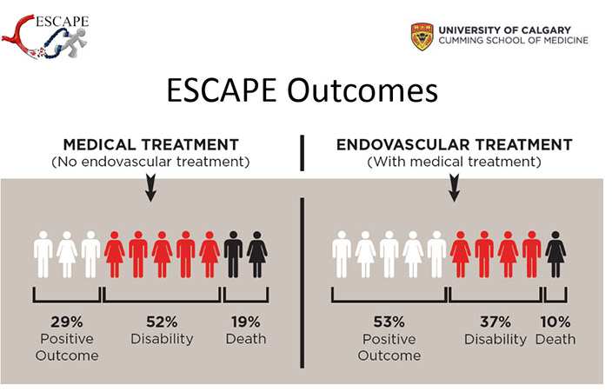
Compare patients who receive tPA alone (on left) to those who receive tPA & EVT (on right)
Shows a decrease in death and disability and an increase in positive outcomes
(Photo courtesy of the Cumming School of Medicine, University of Calgary)

Slide 10
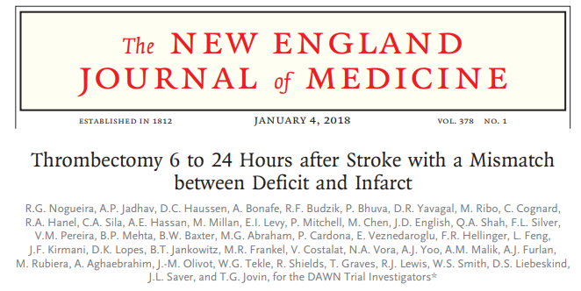
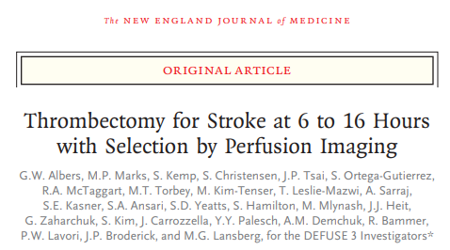
DAWN
DEFUSE 3

Slide 11
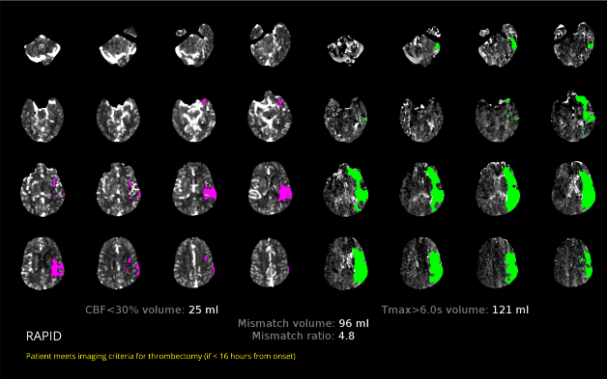
CT Perfusion and RAPID Output
The photo shows an identification of infarct and tissue at risk using the RAPID CT Perfusion software. This software gives an additional layer in the selection process for EVT.
On the left (purple area): indicates the area that has been infarcted.
On the right (green area): shows the part of the brain that is not getting enough blood. Therefore, if you take the clot ,the green area will get reperfused and that tissue will be salvaged.

Slide 12
What is Endovascular Thrombectomy (EVT)?
EVT is a highly specialized procedure involving the mechanical removal of a clot in the brain.
The procedure:
  A catheter is inserted into the femoral artery.
  Using advanced imaging as a guide, the catheter is navigated to the clot in the brain.
  A mesh stent is inserted through the catheter to the clot.
  The catheter is retracted, allowing the stent to expand through the clot. This expansion causes the clot to become trapped within the stent.
  The stent can then be removed, bringing the clot with it and immediately restoring blood flow.

Slide 13
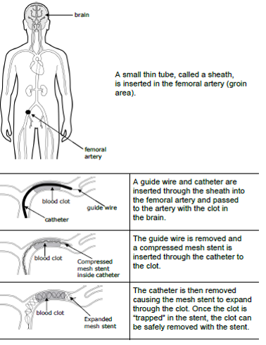
(The above image was created by the Central South Stroke Network: permission was obtained to use image Obtained from LHSC: Clot Retrieval for Stroke, Patient and Family Education pamphlet, 2017.)

Slide 14
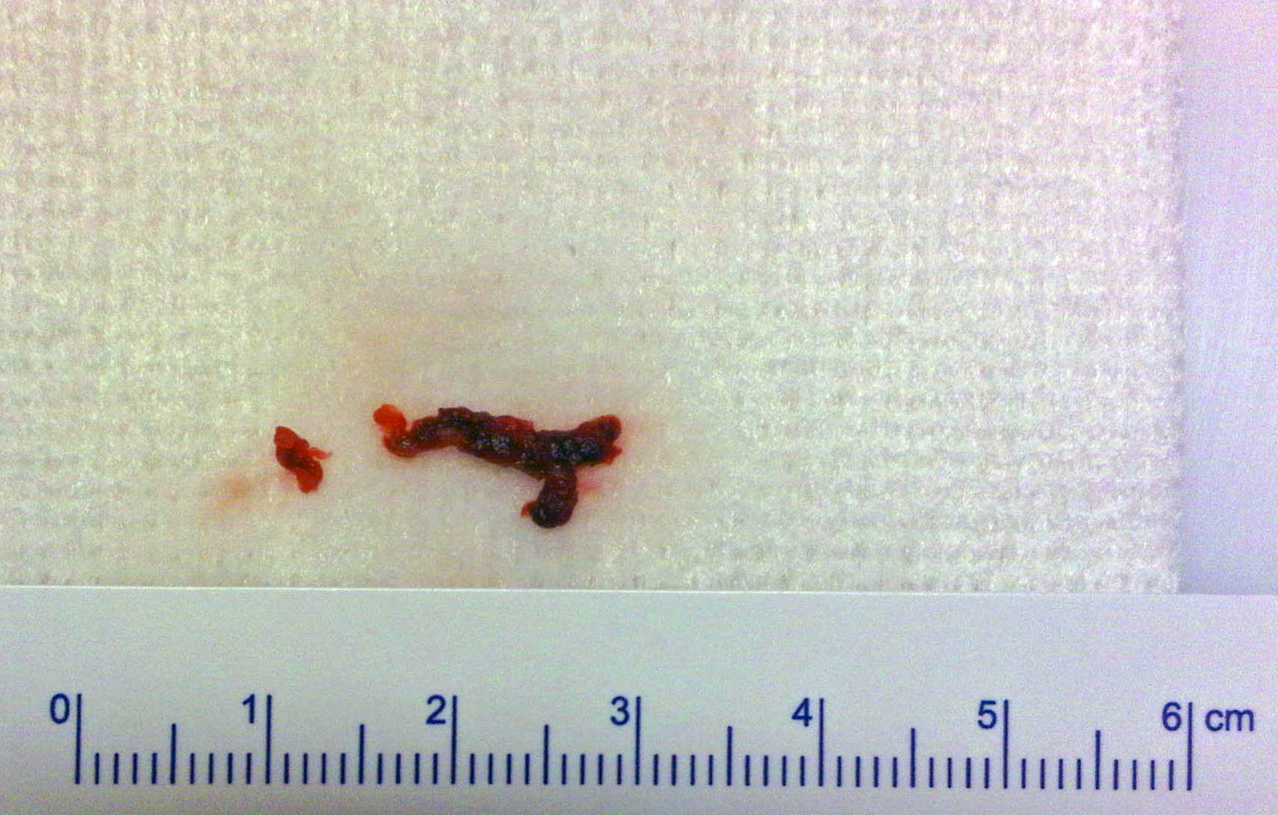
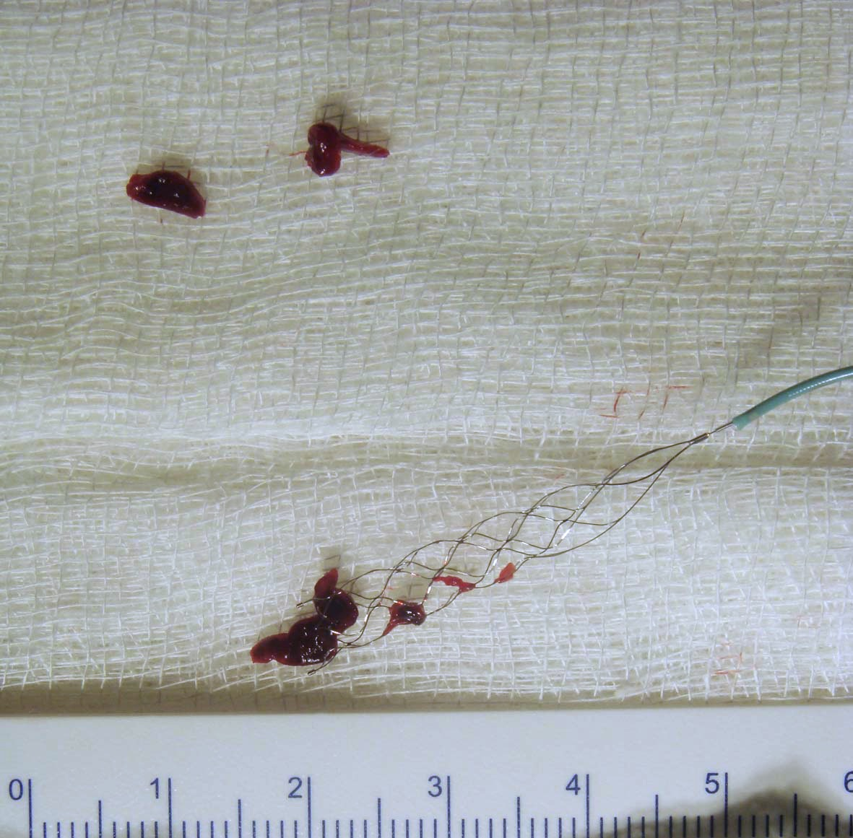
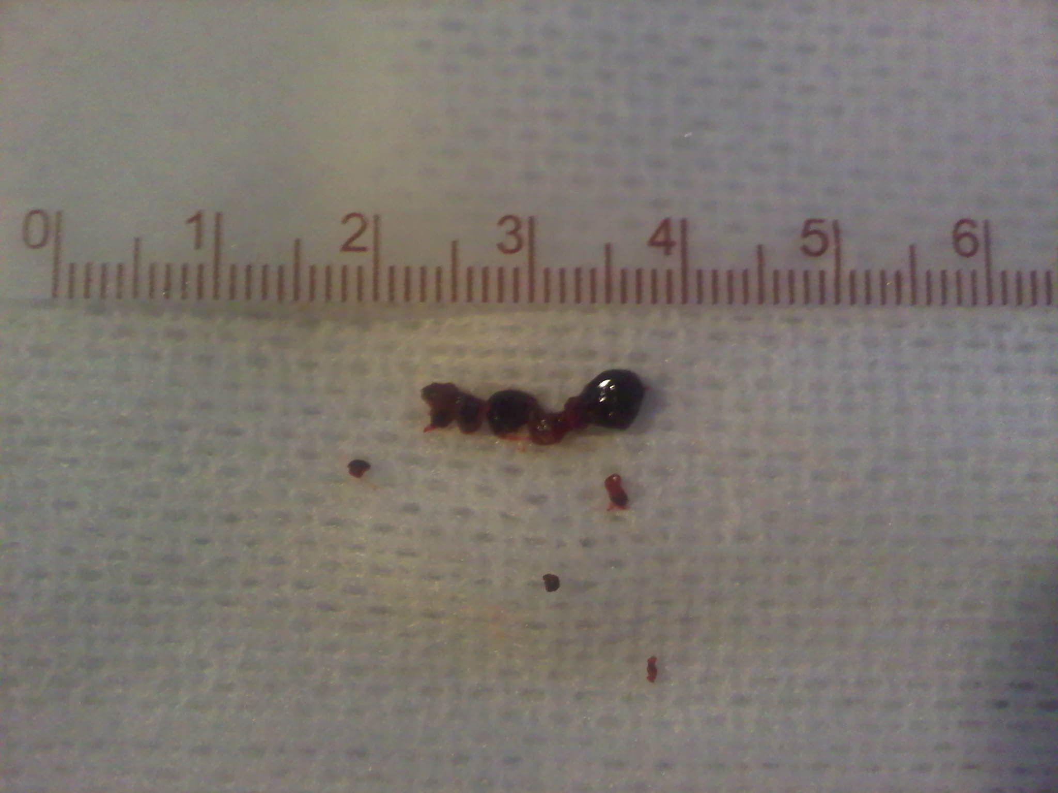
Image Source: Hyperacute Stoke Care, Managed by Telestoke Presentation, Thunder Bay (via videoconference) March 22, 2016
Courtesy of: Dr. Frank L. Silver, MD, FRCP(C), Professor of Medicine (Neurology), University of Toronto Medical Director, Toronto West Stroke Region Co-PI, Registry of the Canadian Stroke Network Medical Director, Ontario Telestroke Program

Slide 15
Hyperacute Stroke Protocol
(6-24-hour Window)

Slide 16
Organizations to insert current acute stroke protocols/algorithms from
6-24 hour window from stroke symptom onset.

Slide 17
Why the Need for the ACT-FAST LVO Screening Tool?
The ACT-FAST large vessel occlusion screen is being used to triage patients who arrive between 6-24 hours from stroke symptom onset and helps guide rapid decision making in the Emergency Department.
The ACT-FAST algorithm has high specificity and reliability for recognizing large vessel occlusion in severe stroke (Zhao et al., 2018).
This tool is used for anterior circulation strokes. If suspecting a posterior stroke, follow usual protocol and inform the physician immediately.

Slide 18
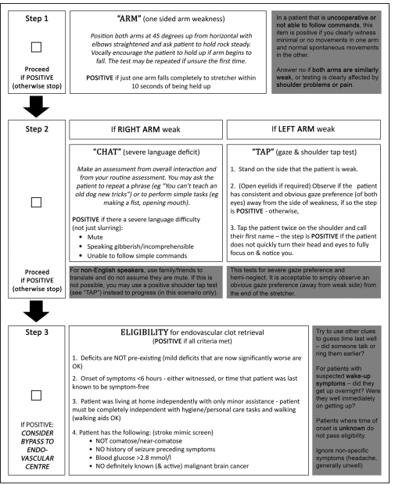
What is the ACT-FAST Stroke Screening Algorithm?
ACT-FAST Algorithm
  The 3-step ACT-FAST algorithm is a simple, rapid, and reliable tool for the identification of LVO who are likely to be eligible for endovascular thrombectomy (EVT).
Source “Ambulance Clinical Triage for Acute Stroke Treatment” Zhao et al. Stroke 2018; 49: 945-951
Notes:
- Please note, this PDF article was based on the research that’s why it says <6hours however this tool can be used to screen up to 24hours.

Slide 19
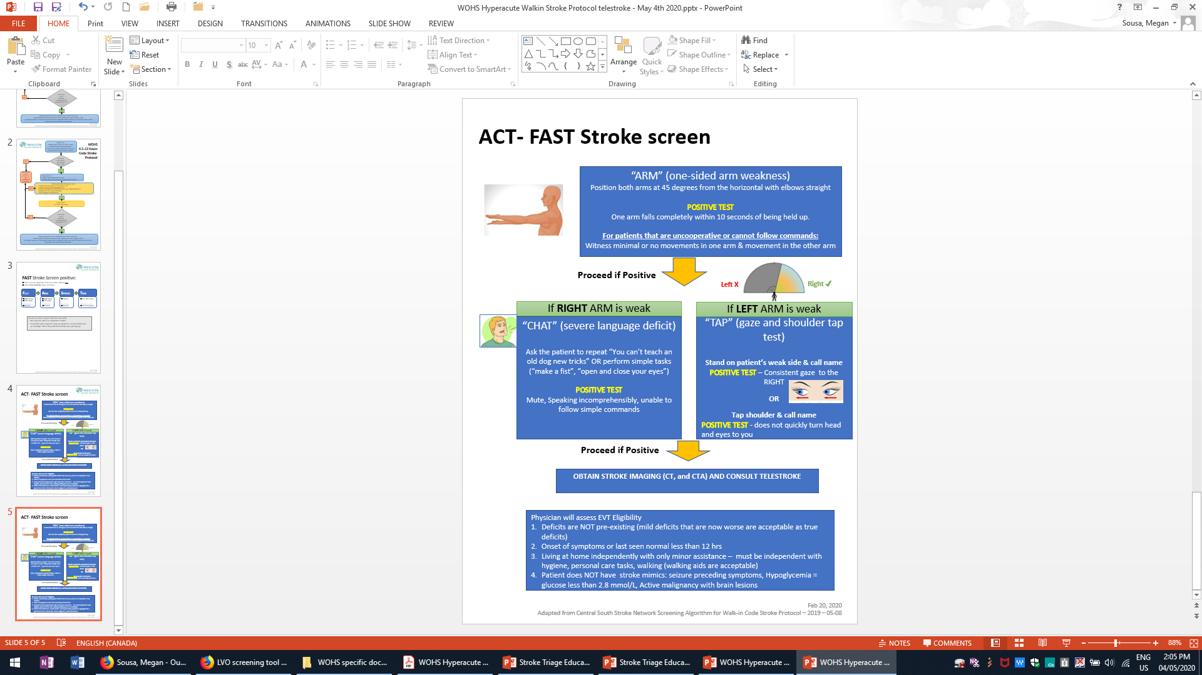
Organizations to insert your own hospital ACT-FAST Tool, this is just an example
ACT-FAST Stroke Screen
Simplified

Slide 20
Additional Tips…
Try to use clues to guess time last seen normal – did someone talk to or call patient?
For suspected Wake-Up symptoms, did patient get up overnight? Were they normal when first getting up?
If patient is uncooperative or cannot follow commands & you clearly witness minimal or no movements in one arm and normal or spontaneous movements in the other arm, THEN proceed to next ACT-FAST Step
If both arms are similarly weak, or testing is clearly affected by shoulder problems or pain, the ED physician can contact the neurologist on call for stroke for consultation
If there is uncertainty as to time of symptom onset or whether a patient meets the ACT-FAST or Acute Stroke Protocol criteria, the ED physician can contact the neurologist on call for stroke for consultation
Adapted from Toronto Stroke Network & “Ambulance Clinical Triage for Acute Stroke Treatment” Zhao et al. Stroke 2018; 49: 945-951

Slide 21
Putting it All Together
Case Studies

Slide 22
Case Study #1 - Mrs. Smith
Mrs. Smith, a 63-yr-old female woke up with left-sided weakness
Last time seen normal 22:00 the night before
Woke at 5:45 feeling unwell
Hx of atrial fibrillation, high blood pressure and high cholesterol
Presents to the ED and examination shows:
  Left sided weakness
  Left arm drift
  Able to answer questions correctly and speech is normal
  Gaze deviation to the right
Please watch the video Case Study 1 “Mrs. Smith”. Video available on the EVT resource centre where you found this PowerPoint Presentation

Slide 23
Case Study – Mrs. Smith
Let’s Score it:
What was Mrs. Smith’s score or result on the ACT-FAST?
  ACT-FAST SCORE = (positive or negative)
Next Steps:
  What would be your next steps?
    Please refer to your organization’s specific acute stroke protocols for more details.
Notes:
ACT-FAST Score POSITIVE for Mrs. Smith
Reasons:
Left arm falls completely within 10 seconds of being held up.
Right gaze deviation.

Slide 24
Case Study #2 - Mrs. Fall
Mrs. Fall, a 81-yr-old female woke up with left-sided weakness
Last felt normal at 01:30 this morning
Woke at 10:30 feeling weak
Hx of cardiac disease, high blood pressure and high cholesterol
Meds: Eliquis, Lipitor, Ramipril
Presents to the ED and examination shows:
  Left arm weakness (could not hold left arm against gravity)
  Normal speech
  Answers questions appropriately
  Normal gaze
  No neglect
Please watch the video Case Study 2 “Mrs. Fall”. Video available on the EVT resource centre where you found this PowerPoint Presentation

Slide 25
Case Study #2 - Mrs. Fall
Let’s Score it:
What was Mrs. Fall’s score or result on the ACT-FAST?
  ACT-FAST SCORE = (positive or negative)
Next Steps:
  What would be your next steps?
    Please refer to your organization’s specific acute stroke protocols for more details.
Notes:
ACT-FAST Score Negative for Mrs. Fall
Reasons:
Although Left arm falls completely within 10 seconds of being held up. Her gaze is not deviated and there is no hemi-neglect.

Slide 26
Case Study #3 - Mrs. Clean
Mrs. Clean, a 81-yr-old female work up with right-sided weakness
Last time seen normal: 2130 the previous night
Fell out of bed at 0400
Hx of atrial fibrillation, high blood pressure and high cholesterol
Meds: Lipitor, Ramipril
Presents to ED and examination shows:
  Left facial weakness
  Right arm weakness (lifts arm up but drifts down)
  Aphasia
  Obeys motor commands
  Normal gaze
  No neglect
Please watch the video Case Study 3 “Mrs. Clean”. Video available on the EVT resource centre where you found this PowerPoint Presentation

Slide 27
Case Study #3 - Mrs. CLean
Let’s Score it:
What was Mrs/ Clean’s score or result on the ACT-FAST?
  ACT-FAST SCORE = (positive or negative)
Next Steps:
  What would be your next steps?
    Please refer to your organization’s specific acute stroke protocols for more details.
Notes:
ACT-FAST Score Positive for Mrs. Clean
Reasons:
Her Right arm falls completely within 10 seconds of being held up.
She has aphasia

Slide 28
Key Messages:
You can choose to leave this slide or not, if you do wish to keep this slide with key messages make it relevant to your organizations processes. Some over-arching examples are in the notes section from the creators of this presentation.
Notes:
Some suggestions from the group that developed the slide deck are:
- Patients can be eligible for EVT up to the expanded time window of 24 hours from last seen normal.
Important to have a LVO screening tool for patients within the expanded time window and adhere to your acute stroke protocol.

Slide 29
References:
  Article related to Dawn Trial
    Thrombectomy 6 to 24 Hours after Stroke with a Mismatch between Deficit and Infarct
    https://www.nejm.org/doi/full/10.1056/NEJMoa1706442
  Defuse 3
    https://www.strokebestpractices.ca/recommendations/acute-stroke-management/acute-ischemic-stroke-treatment
  Canadian Stroke Best Practice Recommendations
    https://www.strokebestpractices.ca/
  “Ambulance Clinical Triage for Acute Stroke Treatment” Zhao et al. Stroke 2018; 49: 945-951

Slide 30
Thank you

