Slide 1
Paramedic Prompt Card for Acute Stroke Bypass Protocol
PARAMEDIC TRAINING | BLS PCS V.3.3
Adapted from The Paramedic Prompt Card for Acute Stroke Bypass Protocol - Paramedic Training Module originally developed by CorHealth Ontario https://www.youtube.com/watch?v=EanfEzCHYc8&feature=youtu.be

Slide 2
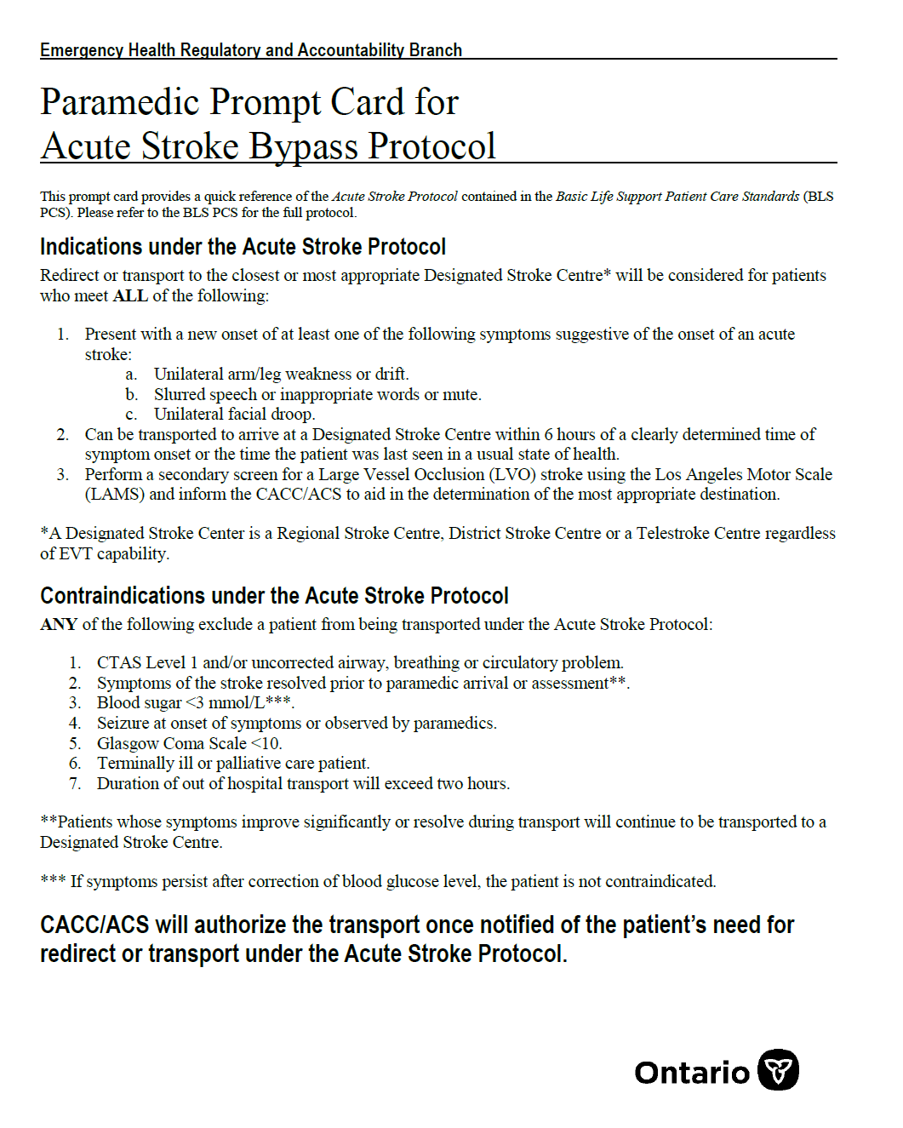
EHS Acute Stroke Bypass Protocol Update
Changes to BLS PCS v 3.3 (In force date: January 11, 2021)
Stroke related changes in BLS PCS v3.3 (“the BLS standards”) include the addition of the LAMS tool to assist in identifying a large vessel occlusion (LVO) stroke
  Cerebrovascular Accident (CVA, “Stroke”) Standard- p. 66
  4. if the patient does not meet any of the contraindications listed in paragraph 3 above, perform a secondary screen for a Large Vessel Occlusion (LVO) stroke using the Los Angeles Motor Scale (LAMS);
  5. inform the CACC/ACS of the LAMS score to assist in the determination of the closest or most appropriate*** Designated Stroke Centre;
  Paramedic Prompt Card for Acute Stroke Bypass Protocol- Appendix A
  “perform a secondary screen for a Large Vessel Occlusion (LVO) stroke using the Los Angeles Motor Scale (LAMS) and inform the CCA/ACS to aid in determination of the most appropriate destination”
Adapted from The Paramedic Prompt Card for Acute Stroke Bypass Protocol - Paramedic Training Module originally developed by CorHealth Ontario https://www.youtube.com/watch?v=EanfEzCHYc8&feature=youtu.be

Slide 3
Learning Objectives
By the end of this session, you will be able to:
  Explain and understand the rationale for the legislated changes to the provincial Paramedic Prompt Card for Acute Stroke Bypass Protocol (Section A: Theory)
  Describe the different applications of the LAMS score in practice (Section A: Theory)
  Apply and score the Los Angeles Motor Scale (LAMS) when assessing a stroke patient in the field (Section B: Application)
Adapted from The Paramedic Prompt Card for Acute Stroke Bypass Protocol - Paramedic Training Module originally developed by CorHealth Ontario https://www.youtube.com/watch?v=EanfEzCHYc8&feature=youtu.be

Slide 4
Section A: Theory
LEARNING OBJECTIVES:
Explain and understand the rationale for the legislated changes to the provincial Paramedic Prompt Card for Acute Stroke Bypass Protocol
Describe the different applications of the LAMS score in practice (Section A: Theory)
Adapted from The Paramedic Prompt Card for Acute Stroke Bypass Protocol - Paramedic Training Module originally developed by CorHealth Ontario https://www.youtube.com/watch?v=EanfEzCHYc8&feature=youtu.be

Slide 5

Time is Brain
Stroke is a medical emergency. It is critical that stroke patients are identified and triaged by EMS personnel in a timely manner to ensure rapid access to stroke treatment
Approximately 2 million neurons,12 km of axons and 14 billion synapses are lost each minute that treatment is delayed¹
Every minute saved in onset-to-treatment granted on average 4.2 days of extra healthy life²
The ischemic brain ages 3.6 years each hour without treatment¹
Dead
Dead
Dead
Salvageable Tissue
Salvageable Tissue
Salvageable Tissue
TIME
Adapted from The Paramedic Prompt Card for Acute Stroke Bypass Protocol - Paramedic Training Module originally developed by CorHealth Ontario https://www.youtube.com/watch?v=EanfEzCHYc8&feature=youtu.be

Slide 6


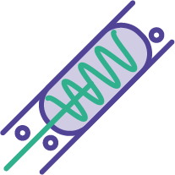


Treatments for Acute Ischemic Stroke
TISSUE PLASMINOGEN ACTIVATOR (tPA)
ENDOVASCULAR THROMBECTOMY (EVT)
tPA and EVT
Thrombolytic agent administered intravenously that dissolves the clot (clot buster)
tPA must be delivered within 4.5 hours of stroke symptom onset
Mechanical removal of a clot using a catheter and stent
EVT is ideally performed within 6 hours of stroke symptom onset. However, this time window may be extended to 24 hours for a select group of patients
A patient can receive both tPA and EVT
Adapted from The Paramedic Prompt Card for Acute Stroke Bypass Protocol - Paramedic Training Module originally developed by CorHealth Ontario https://www.youtube.com/watch?v=EanfEzCHYc8&feature=youtu.be

Slide 7
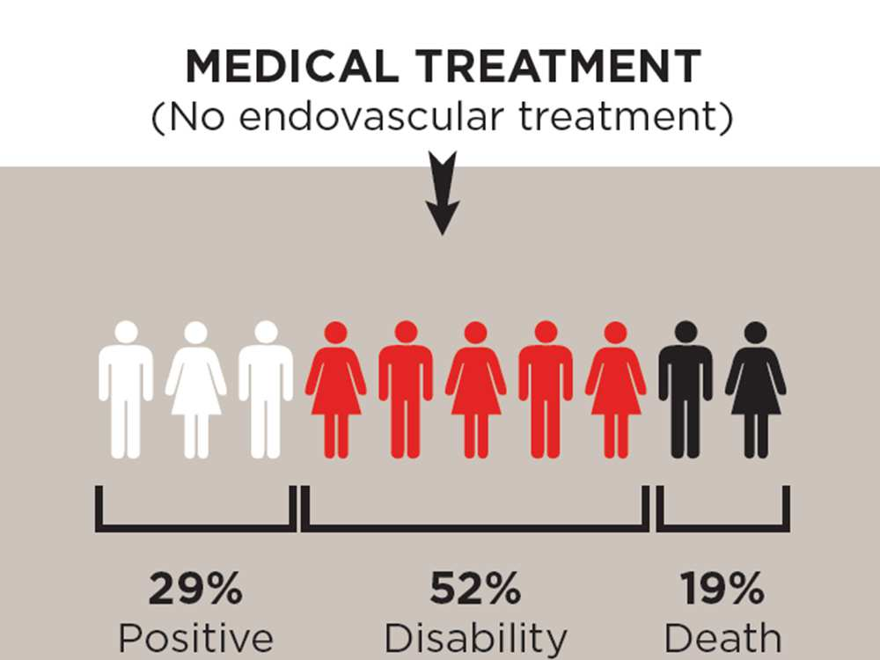
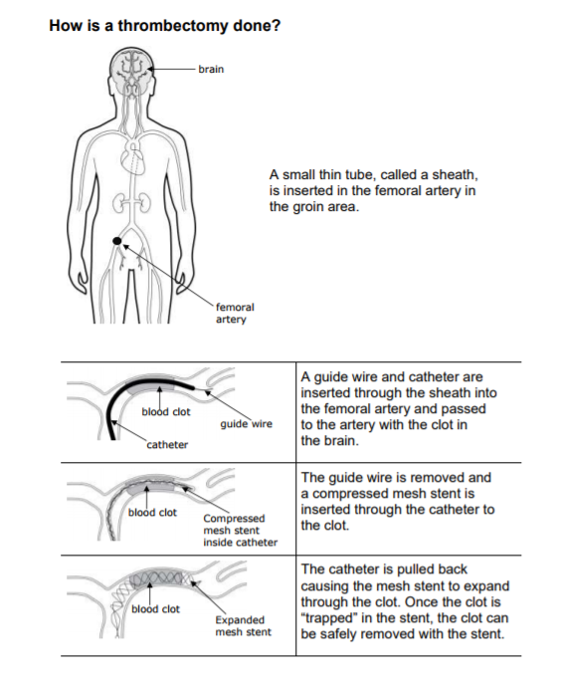
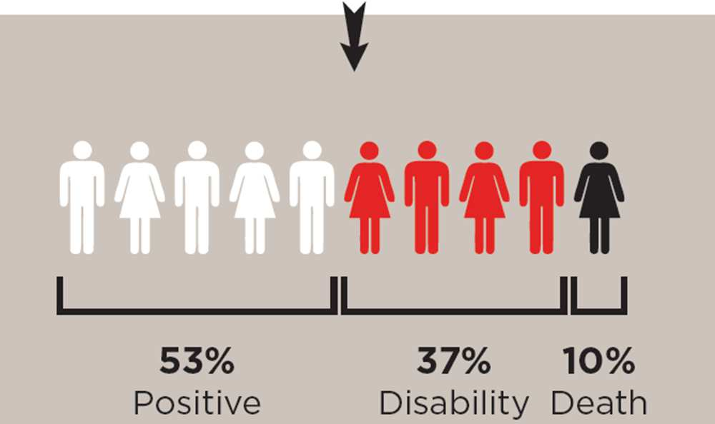
Endovascular Thrombectomy: The Procedure
Medical Treatment (no EVT)
EVT (with medical treatment)
ESCAPE Trial Results³
Adapted from The Paramedic Prompt Card for Acute Stroke Bypass Protocol - Paramedic Training Module originally developed by CorHealth Ontario https://www.youtube.com/watch?v=EanfEzCHYc8&feature=youtu.be

Slide 8
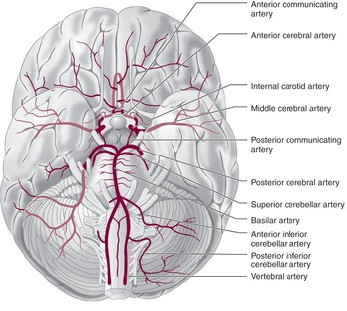

Large Vessel Occlusion (LVO)
Approximately 24% to 46% of ischemic strokes are due to large vessel occlusions⁴
    Large vessel occlusions cause the most severe stroke, resulting in significant disability and often death
Main vessels treated with Endovascular Thrombectomy include:
  Large Vessels of the Anterior Circulation:
    Middle Cerebral Artery (M1 and M2 segments)
    Anterior Cerebral Arteries (A1 segment)
    Internal Carotid Arteries
  Large Vessel Occlusions in the Posterior Circulation (e.g. basilar artery) may be considered based on clinical judgement
Endovascular therapy is more effective than intravenous tPA (Alteplase) for patients experiencing a large-vessel occlusion stroke
Is there a way to identify patients experiencing a large vessel occlusion stroke in the field?
Adapted from The Paramedic Prompt Card for Acute Stroke Bypass Protocol - Paramedic Training Module originally developed by CorHealth Ontario https://www.youtube.com/watch?v=EanfEzCHYc8&feature=youtu.be

Slide 9



Los Angeles Motor Scale (LAMS)
The LAMS tool is a simple and validated assessment of stroke severity
It helps to identify who may be having a large vessel occlusion stroke and be eligible for EVT.
A score of > 4 is considered ‘positive’ for an LVO stroke
FACIAL DROOP
ABSENT: 0
PRESENT: 1
ARM DRIFT
ABSENT: 0
DRIFTS DOWN: 1
FALLS RAPIDLY: 2
GRIP STRENGTH
NORMAL: 0
WEAK GRIP: 1
NO GRIP: 2
Adapted from The Paramedic Prompt Card for Acute Stroke Bypass Protocol - Paramedic Training Module originally developed by CorHealth Ontario https://www.youtube.com/watch?v=EanfEzCHYc8&feature=youtu.be

Slide 10
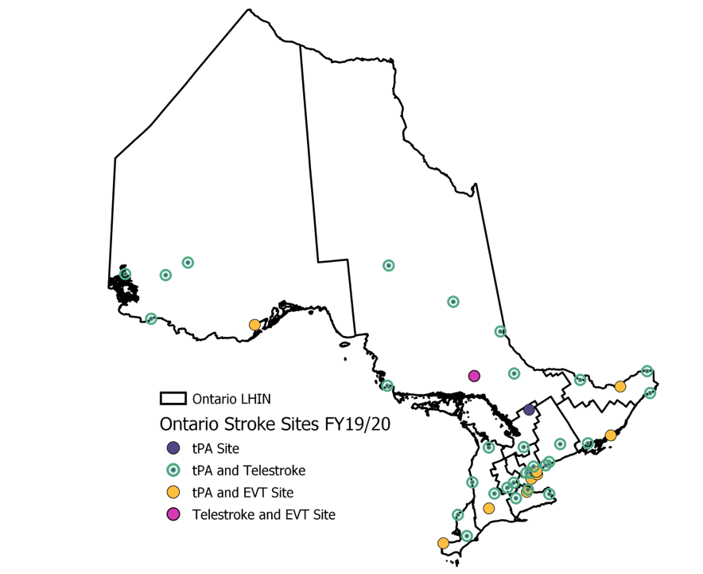
Ontario’s Hyperacute Stroke System
BASIC LIFE SUPPORT PATIENT CARE STANDARDS
Patients who meet the requirements of the Acute Stroke Bypass Protocol can be transported to the closest or most appropriate Designated Stroke Centre
Designated Stroke Centres include:
  Regional Stroke Centres
  District Stroke Centres
  Telestroke Centres
Not all designated stroke centres are EVT capable
Adapted from The Paramedic Prompt Card for Acute Stroke Bypass Protocol - Paramedic Training Module originally developed by CorHealth Ontario https://www.youtube.com/watch?v=EanfEzCHYc8&feature=youtu.be

Slide 11
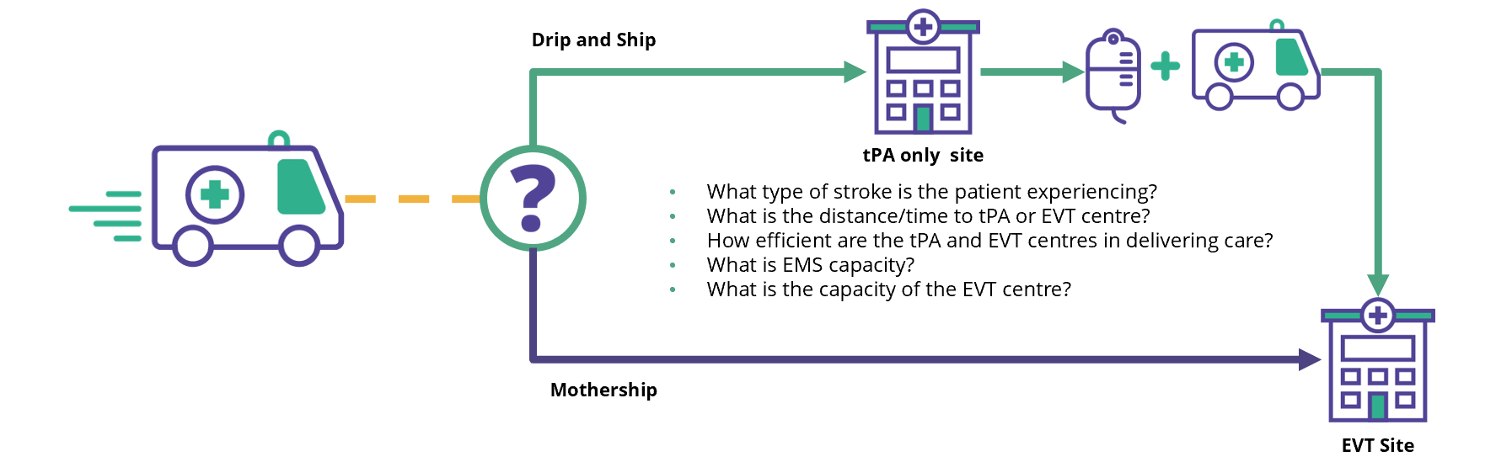



Transportation Model: Drip and Ship or Mothership
Decisions regarding the most appropriate transport destinations are multifaceted and must take into consideration the regional and geographical context.
Drip and Ship
tPA only site
  What type of stroke is the patient experiencing?
  What is the distance/time to tPA or EVT centre?
  How efficient are the tPA and EVT centres in delivering care?
  What is EMS capacity?
  What is the capacity of the EVT centre?
Mothership
EVT Site
Contact your Regional Stroke Network Team, Service or Base Hospital to learn more about the model that will be used in your service area
Adapted from The Paramedic Prompt Card for Acute Stroke Bypass Protocol - Paramedic Training Module originally developed by CorHealth Ontario https://www.youtube.com/watch?v=EanfEzCHYc8&feature=youtu.be

Slide 12


Different applications of the LAMS score in practice
PRE-NOTIFICATION PROCESS
TRANSPORTATION DECISIONS
In all regions, regardless of transport decision, the results of the LAMS screen (generally reported as positive when >=4 or negative when 3 or less) can be used to pre-notify the receiving hospital when the patient is en route
In regions where a mothership model is being used, the tool will help to identify patients who may be eligible for redirection or bypass directly to the EVT capable centre
Adapted from The Paramedic Prompt Card for Acute Stroke Bypass Protocol - Paramedic Training Module originally developed by CorHealth Ontario https://www.youtube.com/watch?v=EanfEzCHYc8&feature=youtu.be

Slide 13
Section A: Quiz
A designated Stroke Centre is a Regional Stroke Centre, District Stroke Centre or a Telestroke (Thrombolysis) Centre regardless of Endovascular (EVT) capabilities
    True
    False
Patients who meet the criteria outlined in the Acute Stroke Bypass Protocol may be redirected to the closest or most appropriate stroke centre if:
    A. They do not meet any of the contraindications listed
    B. They can be transported to a Designated Stroke Centre within 4.5 hours of stroke symptom onset
    C. They can be transported to a Designated Stroke Centre within 6 hours of stroke symptom onset
    A and C
    A and B
Large vessel occlusions are the most common type of ischemic stroke
    True
    False
Adapted from The Paramedic Prompt Card for Acute Stroke Bypass Protocol - Paramedic Training Module originally developed by CorHealth Ontario https://www.youtube.com/watch?v=EanfEzCHYc8&feature=youtu.be

Slide 14
Section A: Quiz
The Los Angeles Motor Scale only needs to be used in regions implementing Direct Access or Mothership Transport Models
    True
    False
EVT is not a time dependent procedure
    True
    False
All designated stroke centres are capable of providing Endovascular Thrombectomy
    True
    False
The Los Angeles Motor Scale is to be used as a primary screening tool to identify patients experiencing the signs and symptoms of stroke
    True
    False
Adapted from The Paramedic Prompt Card for Acute Stroke Bypass Protocol - Paramedic Training Module originally developed by CorHealth Ontario https://www.youtube.com/watch?v=EanfEzCHYc8&feature=youtu.be

Slide 15
Section A: Quiz (ANSWERS)
A designated Stroke Centre is a Regional Stroke Centre, District Stroke Centre or a Telestroke (Thrombolysis) Centre regardless of Endovascular (EVT) capabilities
    True
    False
Patients who meet the criteria outlined in the Acute Stroke Bypass Protocol may be redirected to the closest or most appropriate stroke centre if:
    A. They do not meet any of the contraindications listed
    B. They can be transported to a Designated Stroke Centre within 4.5 hours of stroke symptom onset
    C. They can be transported to a Designated Stroke Centre within 6 hours of stroke symptom onset
    A and C
    A and B
Large vessel occlusions are the most common type of ischemic stroke
    True
    False
Adapted from The Paramedic Prompt Card for Acute Stroke Bypass Protocol - Paramedic Training Module originally developed by CorHealth Ontario https://www.youtube.com/watch?v=EanfEzCHYc8&feature=youtu.be

Slide 16
Section A: Quiz (ANSWERS)
The Los Angeles Motor Scale only needs to be used in regions implementing Direct Access or Mothership Transport Models
    True
    False
EVT is not a time dependent procedure
    True
    False
All designated stroke centres are capable of providing Endovascular Thrombectomy
    True
    False
The Los Angeles Motor Scale is to be used as a primary screening tool to identify patients experiencing the signs and symptoms of stroke
    True
    False
Adapted from The Paramedic Prompt Card for Acute Stroke Bypass Protocol - Paramedic Training Module originally developed by CorHealth Ontario https://www.youtube.com/watch?v=EanfEzCHYc8&feature=youtu.be

Slide 17
Section B: Application
LEARNING OBJECTIVES:
Apply and score the Los Angeles Motor Scale (LAMS) when assessing a stroke patient in the field
Adapted from The Paramedic Prompt Card for Acute Stroke Bypass Protocol - Paramedic Training Module originally developed by CorHealth Ontario https://www.youtube.com/watch?v=EanfEzCHYc8&feature=youtu.be

Slide 18
Screening Tools in the Field- Best Practice
Stroke Diagnosis Screens
  “Patients should be screened for signs of stroke using a validated stroke assessment tool that includes the components of FAST (Face, Arm, Speech, and Time)” (CSPBR, 2018)
Stroke Severity Screens
  “Patients who demonstrate any FAST signs should then undergo a second screen using a tool validated to assess stroke severity, which may be considered in decisions for transportation destination” (CSBPR, 2018)
Adapted from The Paramedic Prompt Card for Acute Stroke Bypass Protocol - Paramedic Training Module originally developed by CorHealth Ontario https://www.youtube.com/watch?v=EanfEzCHYc8&feature=youtu.be

Slide 19



The Los Angeles Motor Scale
FACIAL DROOP
ABSENT: 0
PRESENT: 1
ARM DRIFT
ABSENT: 0
DRIFTS DOWN: 1
FALLS RAPIDLY: 2
GRIP STRENGTH
NORMAL: 0
WEAK GRIP: 1
NO GRIP: 2
LAMS Score >4 indicates a more severe stroke and can be communicated as LVO screen positive
Adapted from The Paramedic Prompt Card for Acute Stroke Bypass Protocol - Paramedic Training Module originally developed by CorHealth Ontario https://www.youtube.com/watch?v=EanfEzCHYc8&feature=youtu.be

Slide 20

Applying the LAMS Tool in Practice
The following three case scenarios were created by the Champlain Regional Stroke Network to support local EMS training
Adapted from The Paramedic Prompt Card for Acute Stroke Bypass Protocol - Paramedic Training Module originally developed by CorHealth Ontario https://www.youtube.com/watch?v=EanfEzCHYc8&feature=youtu.be

Slide 21

Scenario 1: 64-Year-Old, Female
Background
Medical History: Hypertension
Lives at home with her husband in Cobden
At 1630 husband notices wife’s speech was slurred and left side of her mouth seems to be drooping
Husband immediately calls 911
Blood glucose 5.2
Last known well 1630 (30 minutes ago)
Alert, oriented
Skin is pink, warm and dry
Paramedic Assessment
Paramedics arrive on scene at 1700
Paramedic assessment revealed the following:
Using the Paramedic Prompt Card for Acute Stroke Bypass Protocol, paramedics observe a slight left facial droop
Paramedics perform the LAMS
Pulse: 86 bpm, strong & regular
BP 167/92
SpO2: 96%
RR: 16 (no airway obstruction)
Adapted from The Paramedic Prompt Card for Acute Stroke Bypass Protocol - Paramedic Training Module originally developed by CorHealth Ontario https://www.youtube.com/watch?v=EanfEzCHYc8&feature=youtu.be

Slide 22

Scenario 2: 55-Year-Old, Male
Background
Medical History: Smoker x 20 years, diabetes
Lives with wife in Toronto
At 1600, wife found him reclined in a chair, unable to answer questions with look of panic on his red face
Wife immediately calls 911
Blood glucose 10.2
Last known well 1500 (2 hours ago)
Conscious, tries to make eye contact
Right arm appears completely limp at his side
Paramedic Assessment
Paramedics arrive on scene at 1700
Paramedic assessment revealed the following:
Using the Paramedic Prompt Card for Acute Stroke Bypass Protocol, paramedics observe no movement of right arm and aphasia, unable to speak
Paramedics perform the LAMS
Pulse: 92 bpm, irregular, AFIB when put on monitor
BP 158/92
SpO2: 92%
RR: 24 (no airway obstruction)
Adapted from The Paramedic Prompt Card for Acute Stroke Bypass Protocol - Paramedic Training Module originally developed by CorHealth Ontario https://www.youtube.com/watch?v=EanfEzCHYc8&feature=youtu.be

Slide 23
Scenario 3: 61-Year-Old, Male
Background
  Medical History: diabetes, ex-smoker
  Lives with wife in Guelph
  At 0750, sudden onset of slurred speech, left side weakness with upper and lower limbs
  Wife immediately calls 911
Blood glucose 8.9
Last known well 0750 (10 minutes ago)
Alert, oriented
Skin is pink, warm and dry
Paramedic Assessment
Paramedics arrive on scene 0800
Paramedic assessment revealed the following:
Using the Paramedic Prompt Card for Acute Stroke Bypass Protocol, paramedics observe a facial droop and weakness in limbs
Paramedics perform the LAMS
Pulse: 75 bpm, strong and regular
BP 140/90
SpO2: 96%
RR: 16 (no airway obstruction)
Adapted from The Paramedic Prompt Card for Acute Stroke Bypass Protocol - Paramedic Training Module originally developed by CorHealth Ontario https://www.youtube.com/watch?v=EanfEzCHYc8&feature=youtu.be

Slide 24
Section B: Quiz
The three domains captured in the LAMS Tool are:
    Facial Droop, Arm Drift, Grip Strength
    Facial Droop, Speech, Grip Strength
    Speech, Arm Drift, Grip Strength
The LAMS score should be used to identify patients who may be experiencing a stroke
    True
    False
A LAMS score of 4 or higher could indicate a more severe stroke
    True
    False
Adapted from The Paramedic Prompt Card for Acute Stroke Bypass Protocol - Paramedic Training Module originally developed by CorHealth Ontario https://www.youtube.com/watch?v=EanfEzCHYc8&feature=youtu.be

Slide 25
Section B: Quiz
The Los Angeles Motor Scale only needs to be used in regions implementing Direct Access or Mothership Transport Models
    True
    False
The LAMS score should be included as part of the hospital pre-notification process
    True
    False
Patients with a LAMS score of less than 4 are not having a stroke and do not need to be transported to a Designated Stroke Centre
    True
    False
The Los Angeles Motor Scale is a pre-hospital screening tool to assist with determining stroke severity and transportation destination. It is NOT a substitute for a full neurological exam
    True
    False
Adapted from The Paramedic Prompt Card for Acute Stroke Bypass Protocol - Paramedic Training Module originally developed by CorHealth Ontario https://www.youtube.com/watch?v=EanfEzCHYc8&feature=youtu.be

Slide 26
Section B: Quiz (ANSWERS)
The three domains captured in in the LAMS Tool are:
    Facial Droop, Arm Drift, Grip Strength
    Facial Droop, Speech, Grip Strength
    Speech, Arm Drift, Grip Strength
The LAMS score should be used to identify patients who may be experiencing a stroke
    True
    False
A LAMS score of 4 or higher could indicate a more severe stroke
    True
    False
Adapted from The Paramedic Prompt Card for Acute Stroke Bypass Protocol - Paramedic Training Module originally developed by CorHealth Ontario https://www.youtube.com/watch?v=EanfEzCHYc8&feature=youtu.be

Slide 27
Section B: Quiz (ANSWERS)
The Los Angeles Motor Scale only needs to be used in regions implementing Direct Access or Mothership Transport Models
    True
    False
The LAMS score should be included as part of the hospital pre-notification process
    True
    False
Patients with a LAMS score of less than 4 are not having a stroke and do not need to be transported to a Designated Stroke Centre
    True
    False
The Los Angeles Motor Scale is a pre-hospital screening tool to assist with determining stroke severity and transportation destination. It is NOT a substitute for a full neurological exam
    True
    False
Adapted from The Paramedic Prompt Card for Acute Stroke Bypass Protocol - Paramedic Training Module originally developed by CorHealth Ontario https://www.youtube.com/watch?v=EanfEzCHYc8&feature=youtu.be

Slide 28
Acute Stroke Bypass Protocol
Thank you for completing the Acute Stroke Bypass Protocol Training Video
The in-force date for the BLS PCS v 3.3 is: January 11, 2021
For additional information and resources, please contact your Regional Stroke Network Team, Service or Base Hospital
CorHealth Ontario (service@corhealthontario.ca)
Adapted from The Paramedic Prompt Card for Acute Stroke Bypass Protocol - Paramedic Training Module originally developed by CorHealth Ontario https://www.youtube.com/watch?v=EanfEzCHYc8&feature=youtu.be

Slide 29
Reference Slide
Saver, J. Time is Brain –Quantified. Stroke. 2006;37:263-266. Available at https://doi.org/10.1161/01.STR.0000196957.55928.abStroke.
Meretoja A., Keshtkaran M., Tatlisumak T., Donnan G.A.. & Churilov L. Endovascular therapy for ischemic stroke: save a minute—save a week. Neurology. 2017; 88: 2123-2127
Goyal et al (ESCAPE Trial investigators). Randomized Assessment of Rapid Endovascular Treatment of Ischemic Stroke. N Engl J Med 2015 Mar 12;372(11):1019-30.
Rennert, R. C., Wali, A. R., Steinberg, J. A., Santiago-Dieppa, D. R., Olson, S. E., Pannell, J. S., & Khalessi, A. A. (2019). Epidemiology, Natural History, and Clinical Presentation of Large Vessel Ischemic Stroke. Neurosurgery, 85(suppl_1), S4–S8. https://doi.org/10.1093/neuros/nyz042
Other Resources
CorHealth Ontario's Endovascular Treatment (EVT) Resource Centre (http://www.corhealthontario.ca/resources-forhealthcare-planners-&-providers/evt)
Adapted from The Paramedic Prompt Card for Acute Stroke Bypass Protocol - Paramedic Training Module originally developed by CorHealth Ontario https://www.youtube.com/watch?v=EanfEzCHYc8&feature=youtu.be

