Slide 1
CSN INFORMATION AND EVALUATION RESOURCE
Stroke Quality of Care Special Project 340
Data Collection System
Developed by the Canadian Stroke Network
in collaboration with the Canadian Institute for Health Information (CIHI)
and Hamilton Health Sciences Stroke Program
Notes:
Introduction
Title of workshop and identify the group who are participating – province, region, facilities
Introduce presenter and participants – role and facility
Presentation takes approximately one hour
- Participants invited to ask questions throughout presentation
Ensure webex access is working when it is used for presentation

Slide 2

Objectives of Presentation
To set the Context for Stroke Quality of Care Special Project 340 (SQC_SP340)
  Purpose of data collection
  CSN Core Performance Indicator Set
  Link between SQC_SP340 indicators and best practice guidelines
  Position SQC_SP340 in context with national stroke audit 2009
To describe SQC_SP340 Development process
To understand and be able to collect SQC_SP340
Data Elements
Notes:
Review each objective that will be addressed in the presentation very briefly.

Slide 3
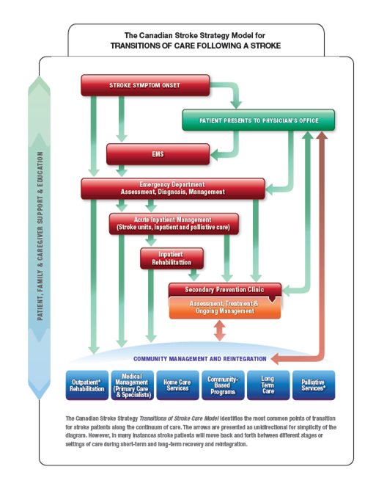
CSN Transitions of Care Model
STROKE
~44,000 admitted stroke & TIA patients annually
Even more strokes that are ‘covert’ with a different set of symptoms
80% caused by blood clots and 20% by bleeding onto the brain
Longest LOS
Leading cause of adult disability
Higher in hospital mortality
Quality of care varies across hospitals, regions and provinces
Very costly to the Healthcare system
Opportunity to improve care exists!
Notes:
Before we go into the details of Stroke Quality of Care Special Project 340 (SQC_SP340), we would like to introduce you to some important information about stroke in Canada (Review the points on the slide)
Stroke is unlike many other conditions, in that it affects the healthcare system, patients and their families across the full continuum of care.
As much as we would like data from all these areas, we have started with a focus on acute care – which includes the emergency department and inpatient setting.

Slide 4
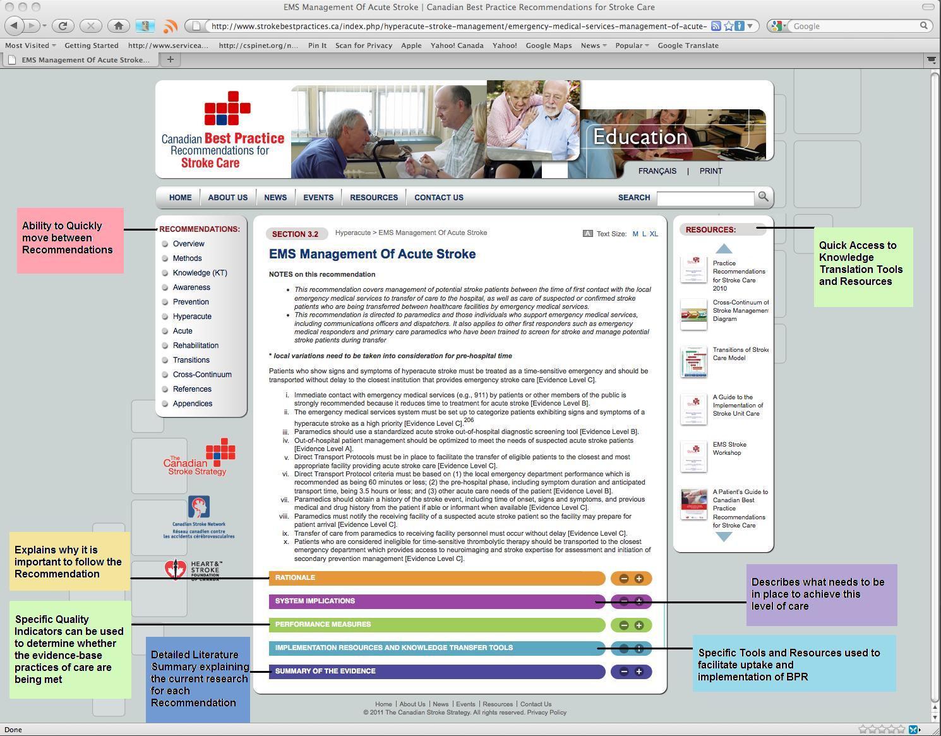
Results- Viewing the
Recommendations on the Website
Notes:
The CSN has gone through very detailed processes to identify performance measures that are directly linked to each of the best practice recommendations we include in our guidelines.

Slide 5
CSN Core Indicators
Update 2010
System
Clinical
* SQC_SP340
^ Accreditation
* ^ Stroke Unit
^ Dysphagia Assessment
^ Rehab assessment within 48 hr
^ Complication Rates
Discharge Location
^ Hospital LOS
* ^ SPC Referrals
* ^ Antithrombotic Rx
^ Antithrombotics for A-Fib
^ Time to CEA
* ^ LSN to ED
arrival time
Stroke
Pre
Hospital
Hyper
acute
Acute
Rehab
Prevention
Community
Risk Factors
Public Awareness S/S
ED/Acute Admissions
^ Mortality
^ Readmission Rates
^ Patient Education
* ^ CT/MRI within 24 hrs
* ^ tPA rates
* ^ DTN Time
^ ASA within 48 hours
^ Admit rates for inpatient rehab
^ Wait times for rehab
^ Change in FIM Score
Discharge location
Rehab LOS
^ Depression Screening
Admission rates to
LTC & CCC
Home care services
Notes:
There are over 150 quality indicators contained within the stroke best practice recommendations.
The CSN has reviewed these extensively and an expert panel has identified a core set among these indicators that are important for stroke care, are supported by the highest research evidence, and we can identify clear actions that can lead to improvements in performance rates – which equals better patient care!
The core indicators cover the entire continuum of care, although data for areas outside inpatient services are much harder to measure.
The indicators with the blue stars are measured by SQC_SP340.
Many of the core indicators are also included a new distinction project by Accreditation Canada that conducts targeted surveys for stroke services. Like all accreditation programs, stroke distinction includes the submission of certain data, and we have done our best to align the data needed for accreditation with the data collected in SQC_SP340. Accreditation indicators are identified by the ‘^’ symbol.
In some cases we are able to statistically define targets or benchmarks for performance, in other cases this can be determined through research. Hospitals may set their own targets based on past performance or desired service levels as well.

Slide 6
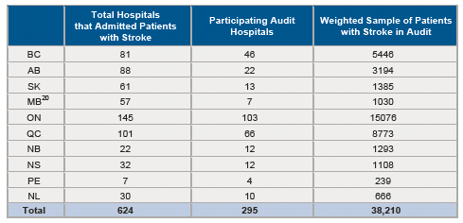
Stroke audit volumes by province
Notes:
In 2009 the CSN conducted the first-ever national stroke audit in Canada.
We included only hospitals with more than 20 stroke admissions per year based on ICD10 coding
The final sample of 295 hospitals represented88% of all strokes
We audited individual charts from approximately a 20% sample of all strokes in Canada
in the Atlantic provinces we included all cases because of the smaller volumes
We will not be able to do an audit of this magnitude with any regular time frame and tehrefore are creating other ways to collect essential stroke data and where-ever possible use existing data collection systems to do so.

Slide 7
Goals of Special Project 340
To build capacity for all hospitals to monitor stroke care delivery consistently regardless of hospital size, location and stroke volumes
To promote standardized and efficient data capture for key process and outcome information based on stroke best practices
To facilitate participation in stroke surveillance, quality improvement, benchmarking and the new Accreditation Canada Stroke Distinction Program
Continue to collect performance data beyond the Quality of Stroke Care Audit
Notes:
There are four main goals in creating SQC_SP340
(Read each point)

Slide 8
Why Special Project 340?
Efficient and cost-effective
  Use of pre-existing data system
  Health records staff already review all stroke charts
  Additional 5 – 10 minutes per stroke chart
Standardized data collection and central location of data within CIHI
  Data accessible to facility and regions routinely
Opportunities for comparative reporting against peers
Notes:
We chose to create SQC_SP340 because we have been using CIHI data already and were able to identify key quality indicators that we needed that were not readily available in NACRS or the DAD already
SQC_SP340 has the advantage of being in an existing platform and does not require double entry or learning a new system
- data is entered by experienced chart abstractors using standardized entry language. This increases data quality
Abstractors have reported that initially it may take an extra 5 to 10 minutes to abstract this data but once you are familiar with it, many have it down to 3 to 4 minutes.

Slide 9

Not fair!! You cannot include us in the comparisons
… we’re special!!
But we are different … we are in a rural setting with no resources
SQC_SP340 is relevant to all acute care organizations
Notes:
Any hospital that treats stroke patients can participate in SQC_SP340. There are no limits to size or volume
- We are able to include all other elements from NACRS and the DAD when we extract SQC_SP340 data, which will allow us to take into account hospital factors and group hospitals appropriately when we are conducting analysis.

Slide 10
Development of Project 340
Discussions between CIHI DAD management and CSN
Data elements selected by CSN IEWG
Review and refinement by CIHI classifications group
Review and approval as a CSN project - Not an ‘official’ CIHI special project therefore not a mandatory project
Bulletin developed and disseminated in June 2009
Revised bulletin in October 2009
Included in DAD data manual for 2010
Starting in NACRS in 2010 for patients d/c from the ED
Notes:
As you know, CIHI only allows a limited number of actual data elements for special projects.
To develop SQC_SP340 we reviewed our broad list of performance measures with CIHI and our own Data evaluation group.
The group selected their top indicators based on importance to stroke, availability of the data, and opportunities to improve care by collecting the data.
Although SQC_SP340 is not mandated by CIHI, several provinces and regions within Canada have mandated participation.

Slide 11

Determining
Feasibility
Value of having information
Cost to obtain data
Notes:
Collecting SQC_SP340 does add to health records coding specialists’ time per chart.
- as mentioned earlier this time decreases as HR coding specialists become more familiar with the charts and work out their own systems for tracking the required data
We were careful in selecting the quality indicators that are included, and have demonstrated that the value of having this information and using it to improve care will outweigh the costs of collecting the data.
- recent cost-avoidance analysis completed for the CSN shows significant cost avoidance if we get patients to hospital faster, provide tPA and access to stroke units to a greater number of people and ensure they have access to rehab early in their recovery

Slide 12
Who is participating in SQC_ SP 340?
Institutions participating in Project 340 in FY 2010-2011
SUBMITTING PROVINCE/TERRITORY | Number of institutions participating in Project 340 | Number of records
Newfoundland - NL | 5 | 139
Nova Scotia- NS | 26 | 1,597
New Brunswick - NB | 15 | 1,004
Ontario - ON | 64 | 9,057
Manitoba - MB | 16 | 1,159
Saskatchewan- SK | 4 | 279
British Columbia - BC | 30 | 1,465
Northwest Territories - NT | 3 | 50
TOTAL | 163 | 14,750
Notes:
** Update this slide before each presentation **
The SQC_SP340 went live for 2009-10 fiscal year.
In 2010 – 2011, 163 hospitals contributed almost 15,000 cases. This represents about one-third of all strokes admitted in Canada
- the numbers will be even more impressive for 2011-12 as more hospitals and regions join this initiative.
Stop here for questions on background information.

Slide 13
CIHI Special Project 340_DAD:
Stroke Performance Improvement
Date and time of stroke symptom onset (92 – 96)
CT Scan / MRI within 24 hours (80)
Admission to a Stroke Unit (81)
Administration of Acute tPA (82)
Date and Time of Acute tPA (83 – 90)
Rx for Antithrombotic Meds at Discharge (91)
340 | X | X | X | M | M | D | D | H | H | M | M | X | Y | YY | YM | MDD | HHMM
79 | 80 | 81 | 82 | 83 | 84 | 85 | 86 | 87 | 88 | 89 | 90 | 91 | 92 | 93 | 94 | 95 | 96
Notes:
This shows the Technical layout in the DAD.
This applies to all patients admitted to hospital with a stroke – case definitions will be reviewed in a few more sldies
- We were given 23 boxes to work within and we did our best to include as many core indicators as we could, that were important to supporting quality of care

Slide 14
CIHI Special Project 340_NACRS :
Stroke Performance Improvement
Date/time of stroke symptom onset (92 – 96)
CT Scan / MRI within 24 hours (80)
Administration of Acute tPA (82)
Date and Time of Acute tPA (83 – 90)
Rx for Antithrombotic Meds at Discharge (91)
Referral to secondary prevention services/clinic (81)
NACRS Project 340 Data Elements 79–96
340 | X | X | X | M | M | D | D | H | H | M | M | X | Y | YY | YM | MDD | HHMM
79 | 80 | 81 | 82 | 83 | 84 | 85 | 86 | 87 | 88 | 89 | 90 | 91 | 92 | 93 | 94 | 95 | 96
Notes:
This is the technical Layout for NACRS.
The only differences are that this applies to patients who were treated in the emergency department and then discharged or transferred from the ED without having an inpatient admission a the same facility.
These patients may be discharged back to the community or transferred to another acute care hospital or long term care home etc.
- Only one data element is different from eth DAD and that is the last one here – instead of tracking stroke unit admissions since that does not apply, the NACRS SQC_SP340 tracks referrals to some type of stroke prevention clinic.
- It is important to ate that if a patient is admitted to the same facility from the ED then only the DAD SQC_SP340 is completed and not NACRS.

Slide 15


Detailed Data Element Review
Notes:
We will now go through each of the data elements included in SQC_SP340 and discuss them in detail.
Please feel free to ask questions along the way so that we ensure everyone understands these clearly by the end of the presentation.

Slide 16
Looking at CIHI 340 Elements
Related Best Practice Recommendation
Why it is important to stroke care?
Who are the stroke cases that are included?
What specific data elements are collected?
When does it occur in the episode of care?
Where is this information documented?
Notes:
For each data element, we will present the related best practice recommendation, then address the 5 ‘W”s …
It is helpful to ask all questions for each indicator before we move on to the next to ensure everyone is comfortable with the required data.

Slide 17
Identification of Appropriate Stroke Cases
The data elements included in this project should be completed for all NEW ACUTE ischaemic and haemorrhagic stroke and transient ischaemic attack cases with an ICD-10-CA Most Responsible Diagnosis (MRDx) or Service Transfer (Type [W], [X] or [Y]) recorded FOR NEW STROKE CASES ONLY or Type (1) (pre-admit comorbidity—FOR NEW STROKES ONLY)
Note: When there are multiple strokes of the same type during the same admission, complete the Stroke Project fields for only the initial stroke.
CIHI DAD Manual 2011-2012, Page 331

Slide 18
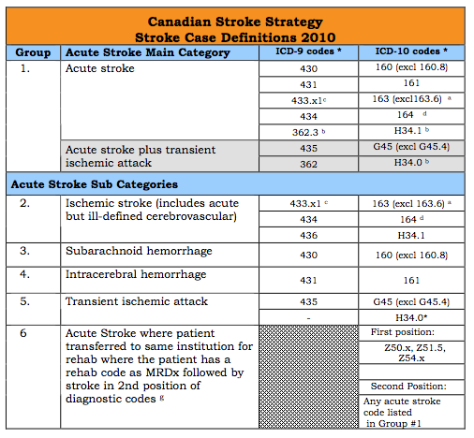
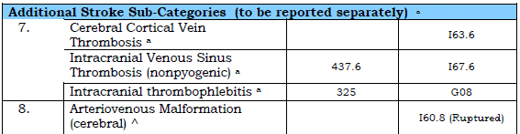
Who should be included in SQC_SP340?
Stroke Case Definitions
(CSN Jan 2010)
MRDx
Notes:
Starting point for SQC_SP340 is understanding which cases should be included in SQC_SP340.
SP340 is designed for all acute stroke cases, as identified by the ICD 10 codes included in this chart.
In most cases the chart should be included if one of the diagnoses on this chart are in the Most Responsible Diagnosis position (M).
In some facilities, stroke patients may get transferred to a rehab bed within the same facility. As a result they may end up with a MRD of a z-code. In these cases, if one of the acute stroke codes is listed as the next diagnosis after the z-code, then the patient should be included in SQC_SP340
note, if a stroke code is listed as a type 1 pre-existing condition and not the original hospital admission dx then patient may not be included.
Sites participating in SQC_SP340 should notify their vendors. Some organizations have had a reminder prompt be triggered when the appropriate ICD codes have been entered.
ICD10 code I64 is an unspecified stroke type diagnosis. This code tends to get overused, and we encourage all facilities to work with their stroke teams and physicians to minimize use of this code, and try to differentiate ischemic stroke from hemorrhage
- Minor stroke and TIAs that are not admitted to hospital will not be captured unless you collect NACRS.

Slide 19
Inclusions and Exclusions
Inclusions | Most responsible diagnosis of Stroke Query Stroke or TIA Z-codes where stroke is the next diagnosis where a stroke patient has been transferred to rehab within the same facility for ongoing care
Exclusions | In Hospital Strokes or Type two Stroke Diagnosis ICD-10: I63.6, I60.8, G45.4
Notes:
There are some additional factors to consider for included and excluded cases:
Cases with a ‘Query’ prefix before one of the acute Stroke or TIA codes should be included – when we do analysis we look at these elements as well as the SP340 elements so we are able to sort and distinguish query cases if needed
Some strokes may occur while a patient is already in hospital for other reasons such as a heart condition, surgery, or even pregnancy. In general, we recommend these cases not be included in SQC_SP340.
Some hospitals may chose to include these cases as they want to specifically track and examine their quality of care.
An organizational or regional decision should be made to either include or exclude these cases so there is consistency among facilities

Slide 20
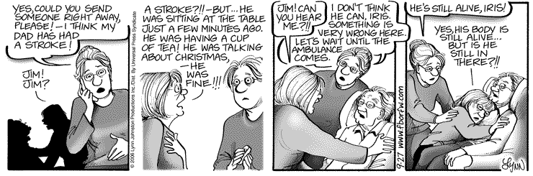
Stroke Symptom Onset Date and Time
Notes:
The first data element included is stroke symptom onset date and time.
This comic strip emphasizes the need for public awareness of the signs of stroke and the need to call 911.
The onset time is the time when symptoms first appear. It may also be referred to as ’last seen normal’ time.

Slide 21
Stroke Symptom Onset Date and Time
Canadian Best Practice Recommendations for Stroke Care 3.1 Patients who show signs and symptoms of hyperacute stroke ( onset <4.5 hours) must be treated as time sensitive emergency cases and should be transported without delay to the closest institution that provides emergency stroke care
Why it is important:
Time is brain - Interventions such as tPA are time-sensitive
Delays to assessment and diagnosis increase morbidity and mortality in stroke
Notes:
Stroke was once considered a condition that could not be treated and therefore not an emergency.
Today there are treatments and these are time sensitive.
The symptom onset time is a critical piece of information as it is the clock start time for acute diagnostics, treatment and other performance measures.
Our best practice recommendations emphasize the need to get to hospital as soon as symptoms start to appear. We have problems with more than half of stroke patients having long delays before coming to hospital. The Canadian stroke audit showed the median symptom onset to hospital arrival time to be 7 hours. This is much too long.
Some reports suggest that for every minute of delay in seeking treatment a million brain cells can be damaged.

Slide 22

Stroke Symptom Onset Date and Time
Who
All stroke and TIA patients
What
The date and time when the stroke symptoms first started
When
On scene by ambulance personnel
Part of the initial evaluation of the patient, in an ED or inpatient setting
  history of presenting illness/ chief complaint
Notes:
This indicator applies to all stroke cases, including those with a query prefix and those with a z-code as the M code
- it is important for the healthcare professionals to get as accurate a time as possible from the patient or a witness
- this should be recorded by paramedics, the triage nurse, and the physicians assessment

Slide 23
Stroke Symptom Onset Date and Time
Where you will find it:
  Ambulance/EMS record
  Triage Nurses’ notes
  ED nurses notes
  ED physicians note
  Admitting MD’s note
  Initial Nursing assessment/ intake
Notes:
- Each healthcare professional who encounters the patient during initial hyperacute assessment and diagnosis should try to obtain this data
- In some cases, the ambulance call records may have a specific spot to chart this, and in many hospitals a special stroke data sheet is included in the chart that contains this information

Slide 24
Approximating Times of Stroke Onset
When Exact Time Not Known
( 24 hour clock format)
Middle of the night | 03:00 | Early afternoon | 14:00
Breakfast | 08:00 | Afternoon or mid-afternoon | 15:00
Early morning | 08:00 | Late afternoon = 16:00 | 16:00
Morning | 09:00 | Dinner/Supper | 18:00
Late morning | 10:00 | Early evening | 19:00
Lunch | 12:00 | Evening | 21:00
Midday | 12:00 | Late evening | 22:00
Noon | 12:00
Notes:
There will be cases where the exact time of the onset of the stroke is not known.
- it may appear as a general statement of time or as an approximate time
this may occur when the patient is alone when the stroke starts, or if it occurs when the patient is sleeping
- The Ontario Stroke Registry has created a time chart to help increase consistency when coding approximate times for stroke onset. Health Records professionals may want to print this and keep it accessible at their work stations
- In cases where the stroke occurred while a patient was asleep, the time they went to sleep would be considered the time to document as it was the ‘last seen normal’ time.

Slide 25
Stroke Symptom Onset Date and Time
CIHI Data Entry (Fields 92 – 96):
Year, Month, Day, Hour, Minute
For unknown data record 9 in the missing fields
There should never be a time where 8 (not applicable) is used.
340 | X | X | X | M | M | D | D | H | H | M | M | X | YY | YY | MM | D D | HHMM
79 | 80 | 81 | 82 | 83 | 84 | 85 | 86 | 87 | 88 | 89 | 90 | 91 | 92 | 93 | 94 | 95 | 96
Notes:
This shows the data entry format
For this indicator there are no exceptions or exclusions therefore the ‘not applicable’ code 8 should never be used
The code ‘9’ should only be used for the parts of the date and time that cannot be found, (example: it only says ‘yesterday’ with no specific time). During the stroke audit, it was very rare for this information to be missing.
- There is an opportunity for health records professionals to let the ED know about SQC_SP340, and post reminders about the data elements that are being collected
any further questions on this section?

Slide 26
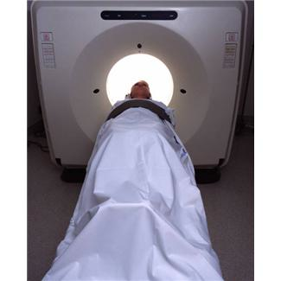
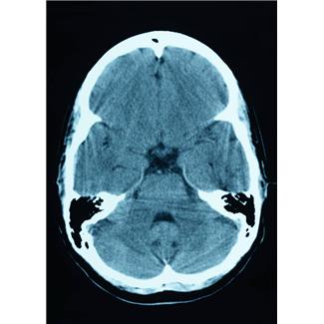
CT Scan/MRI within 24 Hours
Notes:
The next indicator looks at whether the stroke patient received their first scan – either CT or MRI – within the first 24 hours of arriving at hospital.

Slide 27
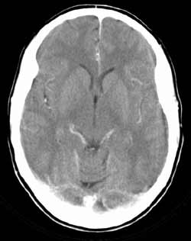
CT Scan/MRI within 24 Hours
Canadian Best Practice Recommendation for Stroke Care 3.3: All patients with suspected acute stroke or TIA should undergo brain imaging immediately
Why it is important:
  Brain imaging is required to guide management
  Differentiate between ischemic and hemorrhagic stroke
Notes:
Our best practice recommendations state that al patients should have a CT or MRI immediately
- this is important because a brain scan is the only way to confirm whether the stroke is caused by a bleed into the brain or by a blood clot. Knowing this information will help guide management
- since some treatments are time sensitive, the timing of the scan is important
The Canadian stroke audit showed that less than two-thirds of patients received a scan in the first 24 hours and there is an opportunity to improve this by tracking the data

Slide 28
CT Scan/MRI within 24 Hrs
Who
All Ischemic Stroke, Hemorrhagic Stroke and TIA
What
Did the patient have some type of initial brain imaging within the first 24 hours after arriving at hospital?
When
part of the initial physician evaluation of the patient, usually in an ED or inpatient setting
  Within the first 24 hours of arriving to a hospital
ED triage time is considered the arrival to hospital
  not registration time or hospital admission time
Notes:
This data element applies to every case, without exception
the time should be determined based on the start time of the scan
When determining this indicator, the ‘TRIAGE TIME’ should be consistently used as the start date and time
According to the CTAS process, triage should be completed before registration. Although this is not consistently done across hospitals, it should be the time used for SP340.

Slide 29
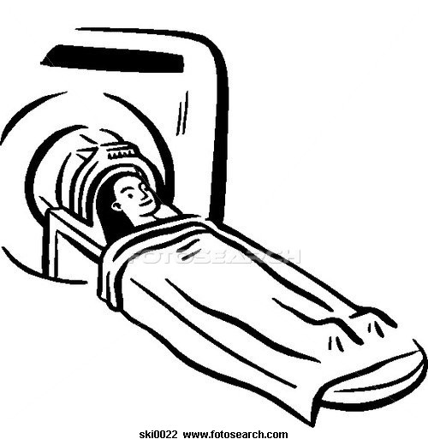
CT Scan/MRI within 24 Hours
Where you will find it:
CT report (will have date and time of scan)
ED/ Inpatient nurses notes
Electronic Radiology order/report
ED physician orders
Inpatient physician orders
Diagnostic Procedures log
Transfer notes
Physician Consult notes
Notes:
The goal here is to determine whether scan done within 24 hours, not the exact time the scan was completed.
The scan report is the preferred document for this element.
If it is not on the chart or accessible electronically, then look to the nurses notes to indicate the time the patient went to imaging or returned from imaging

Slide 30
CT Scan/MRI within 24 Hours
CIHI Data Entry (Field 80): Yes / No
Y if done within 24 hours of arrival
N if not done within 24 hours
P if done at another hospital prior to transfer
340 | X | X | X | M | M | D | D | H | H | M | M | X | YY | YY | MM | D D | HHMM
79 | 80 | 81 | 82 | 83 | 84 | 85 | 86 | 87 | 88 | 89 | 90 | 91 | 92 | 93 | 94 | 95 | 96
Notes:
This is a yes/no data element
- there will be cases where a patient first arrives at a different facility, undergoes brain imaging, then is sent to your facility as either a transfer up to a higher level of care, or as a repatriation to a smaller hospital.
In these cases, if a brain scan was done at the first hospital within 24 hours of first hospital arrival, then enter ‘P’ fr done prior to arrival at your facility.
- any further questions on this section??

Slide 31


Admission to a Stroke Unit
Stroke Unit
PT
OT
RN
Interprofessional
Stroke Unit Bed #4
Notes:
This next section looks at the location in the hospital where stroke patients are cared for during inpatient stay.
Note: if the patient is discharged from the ED without an inpatient stay, then this data element does not apply to NACRS.

Slide 32
Admission to a Stroke Unit
Canadian Best Practice Recommendation for Stroke Care 4.1: Patients admitted to hospital because of an acute Stroke or TIA should be treated in a designated and geographically defined stroke unit
Why it is important:
High level evidence that demonstrates stroke patients who are treated on a stroke unit have lower death and disability rates
Notes:
Our best practices state that all patients should be treated on a stroke unit, with the exception of patients with subarachnoid hemorrhage
The research evidence is very strong in demonstrating that stroke patients treated on a designated stroke unit have better outcomes, and less disability

Slide 33
Special Notes about Stroke Units:
Definition of a stroke unit:
“ A specialized, geographically defined hospital unit dedicated to the management of stroke patients” (CBPR 4.1)
Do you have a stroke unit?
  Each facility should establish if they have a stroke unit that meets the CSN definition
If yes, where is it located in the hospital?
  Health records should know where the stroke unit is located (i.e., ward/location code)
Note: clustering of stroke patients in the absence of a stroke unit should not be considered as a ‘yes’ for this measure
Notes:
It is important to establish whether or not your hospital has a stroke unit, and identify the name of the ward or location of the stroke unit
- this slide shows the official definition of a stroke unit
If your hospital does not have a stroke unit this data element is not applicable.
Some hospitals try to cluster stroke patients on one ward without having an official stroke unit. Each facility has to look at their model and if they meet all the criteria that is included in stroke unit care – except having the official sign over the door – then they may choose to collect this information to track patients
it is very important to determine stroke unit status at the outset of SQC_SP340, to ensure that all health records professionals are coding the same way for this element
– if unsure how to collect this for your site then check with your stroke team or you can contact Dr. Lindsay for assistance
__ have a brief discussion on the call to determine stroke unit status for facilities participating on the call.

Slide 34
Admission to a Stroke Unit
Who
All admitted Ischemic Stroke, intracerebral hemorrhagic and TIA patients
Only during acute inpatient care, this does not include admission to a stroke rehab unit, even if in same facility
What
Did the patient spend any time during the acute care admission on a designated stroke unit? **Need to confirm whether there is a clearly defined stroke unit
When
During admission …
  Directly from the ED
  After an ICU admission
  Transfer from ward when SU bed available
Notes:
All stroke patients are included in this data element except subarachnoid hemorrhage, as they generally go to the ICU instead
To answer this element, consider whether they spent any time on the stroke unit, either transfer directly from the ED or whether they first went to a bed located in a different ward then were transferred later to the stroke unit.
The indicator states ‘any time on a stroke unit’ and there is no minimal #days limit to this element

Slide 35
Admission to a Stroke Unit
Where you will find it:
Hospital Admissions Register
Nurses notes
CIHI Data Entry (Field 81): Yes / No
Y if admitted to a stroke unit at any time
N if there is a stroke unit, but the patient was never treated on the stroke unit
8 if there is no stroke unit at the facility or patient is SAH
340 | X | X | X | M | M | D | D | H | H | M | M | X | YY | YY | MM | D D | HHMM
79 | 80 | 81 | 82 | 83 | 84 | 85 | 86 | 87 | 88 | 89 | 90 | 91 | 92 | 93 | 94 | 95 | 96
Notes:
If there is a stroke unit at the hospital then there should always be either a yes or no answer – they were either on the unit or not
The ‘not applicable’ code of 8 should only be used if there is no stroke unit or if the patient was diagnosed with a subarachnoid hemorrhage
If you are unable to determine their location from the chart then select ‘no’

Slide 36

Administration of Acute Thrombolysis
Time
is
Brain
4.5
Notes:
- Acute thrombolysis is known as the Clot busting drug that can be given to patients with stroke caused by a clot
It is time sensitive and is to be given within 4.5 hours of the onset of stroke symptoms
- it is important for the health records department to check with the emergency department at the outset of SQC_SP340 to determine whether or not tPA is available for stroke patients at the hospital.

Slide 37
Administration of Acute Thrombolysis
Canadian Best Practice Recommendations for Stroke Care 3.5: All patients with disabling acute ischemic stroke who can be treated within 4.5 hours after symptom onset should be evaluated without delay to determine their eligibility for treatment with IV tPA
Why it is important:
Strong evidence finds tPA has been shown to reduce risk of disability and death in patients with ischemic stroke treated within 4.5 hours of symptom onset
Notes:
- Our best practice recommendation states that all patients with ischemic stroke should be evaluated for their eligibility for tPA
As you may recall from an earlier data element, to determine eligibility a CT or MRI scan has to be completed first
Patients who receive tPA have better outcomes and less chance of dying from their stroke

Slide 38
Administration of Acute Thrombolysis
Who
All Ischemic Stroke patients that present to hospital within 4.5 hours of the onset of stroke symptoms
What
Patients who received Alteplase ( tissue plasminogen activase, Activase, tPA, r-tPA)
When
Almost always in the ED before patient admitted
  Very rarely in other locations such as inpatient or SU
Notes:
Acute thrombolysis medication is only given for ischemic stroke
This includes all patients with ICD10 code of I63. We also include I64 in this element as we have found that many I64 patients are ischemic. This may be over counting the denominator but between than undercounting and resulting in tPA rates that are much higher than the reality of who is eligible
- important to note that TIA patients are not included in this data element, and all hemorrhagic patients (SAH and ICH) are excluded
- unlike for cardiac patients where there are a few medications that can be used, only one clot busting drug is used for stroke patients - tPA

Slide 39

Administration of Acute Thrombolysis
Where you will find it:
ED r inpatient medication records
MD orders
  Most hospitals have preprinted order sets for tPA administration
Progress/ Consult notes
ED nurses notes
Discharge summary
Notes:
The physician orders will indicate whether tPA has been prescribed, and the ED medication record will have confirmation that the medication was administered and the time
Many hospitals have special tPA order sets and these will be on the chart of they exist – suggest that your department find out of your hospital uses special forms for tPA administration
most hospitals give tPA in the ED, and for some hospitals they patient will become admitted before tPA is given
tPA is usually administered in two parts – first with a bolus of some of the drug, then the rest is given by an IV drip
- some hospitals may also give tPA by inserting a catheter into the vessels of the brain. This will be recorded as ‘intra-arterial- tPA’ (IA) and still counts for this data element.
most patients who receive IA tPA also get IV tPa as well.

Slide 40
Administration of Acute Thrombolysis
CIHI Data Entry (Field 82): Yes / No
Y if the patient received tPA
N if the patient did not receive tPA
P if tPA was given at another facility prior to direct transfer
X if your facility does not provide tPA
8 Not applicable ( TIA, ICH,SAH)
340 | X | X | X | M | M | D | D | H | H | M | M | X | YY | YY | MM | D D | HHMM
79 | 80 | 81 | 82 | 83 | 84 | 85 | 86 | 87 | 88 | 89 | 90 | 91 | 92 | 93 | 94 | 95 | 96
Notes:
There are several coding options for this data element
For all I63 and I64 cases, the drug is either given or it is not, so these cases should almost always have a yes or no
If your hospital does not give tPA, then always use the X code.
if the patient is TIA, or one of the hemorrhage codes then hat is the only time ‘not applicable’ should be used
There will be some cases where a patient is transferred to your hospital after tPA is given – either because the patient needs a higher level of care or as a repatriation back to a smaller hospital for ongoing management after tPA
In these cases, YES you include the patient in your data if they have been admitted to your hospital and use the ‘P’ code for tPA administration
- any other questions about this data element?

Slide 41
Date and Time of Administration of Acute Thrombolysis
4.5 hr
Time
is
Brain
Notes:
For all patients who receive tPA, it is important to also include the time to administration.
Times for medication administration are not included anywhere else in the DAD or NACRS

Slide 42
Administration Time for Acute Thrombolysis
Canadian Best Practice Recommendations for Stroke Care 3.5: All patients with disabling acute ischemic stroke who can be treated within 4.5 hours after symptom onset should be evaluated without delay to determine their eligibility for treatment with IV tPA
Why it is important:
tPA is safe only when given within a therapeutic window up to 4.5 hours from symptom onset, so ED’s must mobilize rapidly and efficiently
Inverse relationship between treatment delay and clinical outcomes ( quicker is better)
Notes:
The research on tPA has shown that it is most effective when given within the first three hours from the onset of stroke symptoms, and is still effective up to 4.5 hours.
- After that time the risks of having complication such as bleeding into the brain from the tPA medication increases
there is current research going on to look at the safety of giving tPA up to 6 hours after symptom onset
- IA tPA can be given up to 6 and even up to 9 hours after symptom onset in some cases

Slide 43
Administration Time for Acute Thrombolysis
Who
Ischemic Stroke patients that receive tPA
What
What is the door-to-needle time for tPA administration?
Did the patient receive Alteplase (tissue plasminogen activase, Activase, tPA, rtPA) as their treatment for acute ischemic stroke within 60 minutes of arrival to ED (Current benchmark target)?
When
In ED within the first few hours of arrival
Triage time used as start time for DTNT calculations
Notes:
Only patients who receive tPA are included
Most patients who receive IA tPA also get IV tPA first and it is the time of the first administration (usually IV) that gets counted in this data element
- our quality indicators for this include the median time from arrival at hospital to administration of tPA and also the percent of patients who receive tPA within 60 minutes, which is the target time
- with the time of administration that you enter, we can calculate this information
As with CT and MRI scans, we will always use the triage time as the start time for calculating door to needle times

Slide 44
Administration Time for Acute Thrombolysis
Where you will find it:
tPA is given by an RN in the ED
  ED medication record
  Medication profile, single order medication
  Signature on MD order
  Nurses notes
  tPA standing order sheet
Should always have the exact time of administration
Time to record is the start time of administration (medication is infused over 1 hour)
Notes:
The best place to find this information is on the special tPA administration form if your hospital uses them
Otherwise the medication record for the ED or inpatient would be the best place.
- as mentioned earlier, tPA is given as a bolus of part of the drug, followed by an IV of the remaining part of the drug
The time the bolus is given should be the time you record, not the time the IV administration was completed

Slide 45
Administration Time for Acute Thrombolysis
CIHI Data Entry (Fields 83 – 90):
Enter Month, Day, Hour, Minutes
For unknown data record 9
For not applicable record 88888888 (ICH, SAH, TIA, or if hospital does not give tPA, or the patient DID NOT receive tPA even if they were ischemic)
340 | X | X | X | M | M | D | D | H | H | M | M | X | YY | YY | MM | D D | HHMM
79 | 80 | 81 | 82 | 83 | 84 | 85 | 86 | 87 | 88 | 89 | 90 | 91 | 92 | 93 | 94 | 95 | 96
Notes:
We did not include the year in this element as for most cases the year will be the same as the symptom onset
We did choose to include month as well as day for cases where they happen to occur between the 30th/31st and 1st of the next month
we need the hours and minutes to be as accurate as possible for this data element
The not applicable code ‘8’ should be used where no tPA was given – regardless of the reason why it was not given
The unknown code 9 should only be used of the patient receives tPA and you can absolutely not find an administration time – this should be a very rare occurrence
- any other questions about this data element?

Slide 46


Prescription for Antithrombotic Medication at Discharge
Notes:
All patients with ischemic stroke or TIA should be given a prescription to start aspirin or another antithrombotic before they leave hospital
We are tracking this data element as the last one in SQC_SP340

Slide 47
Prescription for Antithrombotic Medication at Discharge
Canadian Best Practice Recommendations for Stroke Care 2.5: All patients with Ischemic Stroke or TIA should be prescribed antiplatelet therapy for secondary prevention of recurrent stroke unless there is an indication for an anticoagulant
Why it is important:
Studies on antiplatelets for stroke have found they can reduce further vascular events by more than 25%
Notes:
Our best practice recommendations state that all ischemic and TIA patients should receive some form of antithrombotic to greatly reduce the chance of another clot forming and causing another TIA or more serious stroke- patients who have had a TIA have a 10% chance of having a bigger stroke within three months, and most of that risk happens in the first 2 weeks after the TIA

Slide 48
Prescription for Antithrombotic Medication at Discharge
Canadian Best Practice Recommendations for Stroke Care 2.6: For the secondary prevention of stroke, patients with atrial fibrillation who have had a stroke/TIA should be treated with warfarin at a target international normalized ratio of 2.5, range 2.0 to 3.0, if they are likely to be compliant with the required monitoring and are not at high risk for bleeding complications.
Why?
Stroke caused by atrial fibrillation is highly preventable if patients are treated with anticoagulants (blood thinning medications). The risk of another stroke can be reduced by one-third or more in compliant patients.
Notes:
Some patients with TIA or ischemic stroke also have a heart rhythm problem known as atrial fibrillation. These patients have a higher risk of stroke and also need to be on an antithrombotic regardless of whether they have had a first stroke or not yet
For SP340, they are included if they have had a stroke or TIA and have afib

Slide 49
Prescription for Antithrombotic Medication at Discharge
Who
Ischemic Stroke and TIA patients
What
Was the patient prescribed antithrombotic medications for ongoing stroke prevention at discharge?
When
At discharge from hospital- either from the ED or inpatient setting
Notes:
This data element applies to all ischemic stroke and TIA patients - this also includes patients with the I64 ICD10 code and the H codes for retinal TIA or retinal stroke
It does not apply to patients with either type of hemorrhage
Patients are usually started on these medications in hospital and given a prescription for them when they are discharged.
This applies to both inpatients and patients discharged directly from the ED

Slide 50

Common Antithrombotic Agents
Antiplatelet Agents:
  Aspirin (ASA, ECASA)
  Clopidogrel (Plavix)
  Dipyridamole plus ASA (Aggrenox)
  Ticlopidine (Ticlid)
Anticoagulants:
  Warfarin ( Coumadin)
  Dabigitran (Pradax)
  Rivaroxaban (Xarelto)
  Apixaban (Eliquis)
Heparinoids (Injections):
  Heparin, Enoxaparin (Lovenox)
  Fondaparinux (Atrixa)
Notes:
There are several types of antithrombotic medications that are prescribed for ischemic stroke and TIA patients, and the most commonly used medications are listed here
- Patients with ischemic stroke or TIA who also have atrial fibrillation are more likely to be prescribed an anticoagulant, but some may receive just an antiplatelet

Slide 51

Prescription for Antithrombotic Medication at Discharge
Where you will find it
Discharge summary
Discharge medication list
Discharge prescription copy
Face sheet
Discharge communication tool
Inter-facility Transfer Sheet
MD orders
Nurses Notes
Notes:
Most hospitals will have a standard place where all the discharge medications are listed
- even non-prescription medications such as aspirin will be listed on these documents

Slide 52
Prescription for Antithrombotic Medication at Discharge
CIHI Data Entry (Field 91): Yes / No
Y if there is documentation that the patient was given a prescription for Antithrombotics
N if the patient was not prescribed Antithrombotics or there is no documentation that the patient was given a prescription for Antithrombotics
9 if discharge notes/summary not available
8 Not applicable (ICH,SAH)
340 | X | X | X | M | M | D | D | H | H | M | M | X | YY | YY | MM | D D | HHMM
79 | 80 | 81 | 82 | 83 | 84 | 85 | 86 | 87 | 88 | 89 | 90 | 91 | 92 | 93 | 94 | 95 | 96
Notes:
There are several options for data entry for this element
- if this is an ischemic stroke, TIA or I64 case then they should be coded as either yes if one of the antithrombotic drugs is listed or no if none of these drugs are included in the discharge medication list
the unknown code 9 should only be used of they are ischemic, TIA or I64 and no discharge summary or medication list can be found- the not applicable code 8 should only be used if the patient was a hemorrhagic stroke (I60 or I61)

Slide 53


Referral to Stroke Prevention Services/Clinic at Discharge from the ED
Stroke Prevention
Clinic
Notes:
For patients discharged directly from the ED without an inpatient admission we have replaced the stroke unit admission data element with an indicator on whether the patient was referred to an outpatient stroke prevention clinic or vascular clinic for further assessment and management

Slide 54
Referral to Stroke Prevention Services/Clinic at Discharge from the ED
Canadian Best Practice Recommendations for Stroke Care 3.2: Patients with suspected transient ischemic attack or minor stroke should be referred to a designated stroke prevention clinic with an interprofessional stroke team, or to a physician with expertise in stroke assessment and management. If these options are not available, to an emergency department that has access to neurovascular imaging facilities and stroke expertise.
Why it is important:
The risk of recurrent stroke after a transient ischemic attack is 10% to 20% within 90 days, and the risk is “front-loaded” with half of strokes occurring in the first 2 days.
Notes:
Our best practices recommend that all patients discharged directly from the ED with a TIA or non-disabling stroke – one that does not cause significant mobility problems or deficits – should have a follow-up in a prevention clinic to better understand what caused the event and to ensure the patient is on the proper management plan to reduce the risk of further events
As mentioned earlier there is a high risk that a patient who had a TIA or small stroke could have another one within 3 months. This risk can be significantly reduced with proper management

Slide 55
Referral to Stroke Prevention Services/Clinic at Discharge from the ED
Who
All Stroke and TIA patients discharged directly from the ED
What
Was the patient given a referral appointment by the ED staff for an appointment with stroke prevention services (at a prevention clinic or stroke specialist)?
When
At discharge from the ED
Notes:
This data element applies to all stroke cases, and only in the NACRS database if your hospital participates in NACRS
- you should look to see if there is any documentation that a referral appointment was made for the patient
Comments like ‘patient instructed to follow-up with their family physician’ do not count as a yes in this data element

Slide 56
Referral to Stroke Prevention Services/Clinic at Discharge from the ED
Where you will find it:
Physician notes
Nurses notes
MD order sheet
Copy of referral on chart
Notes:
This type of referral should be noted in the ED record or discharge note and follow-up section-
it may state stroke prevention clinic or vascular clinic pr just prevention clinic or other similar terminology that might be common at your facility

Slide 57
Referral to Stroke Prevention Services/Clinic at Discharge from the ED
CIHI Data Entry (Field 81): Yes / No
Y if there is documentation that the patient was given a referral for prevention clinic follow-up
N if there is no documentation for a referral to any stroke follow-up clinic
340 | X | X | X | M | M | D | D | H | H | M | M | X | YY | YY | MM | DD | HHMM
79 | 80 | 81 | 82 | 83 | 84 | 85 | 86 | 87 | 88 | 89 | 90 | 91 | 92 | 93 | 94 | 95 | 96
Notes:
All stroke and TIA patients discharged from the ED either received a referral or they did not, so the coding here is either yes or no
- if there is no indication or the information is not clear that there was a referral made, then code NO
As noted earlier, if the note indicates the patient should follow-up with their personal physician but no specific referral to a prevention clinic is made then answer NO

Slide 58
The Elements in Special Project 340 …
measure how we deliver stroke care
are very important clinically
will drive quality improvement efforts
are linked to best practice stroke care performance and Accreditation Stroke Distinction performance
should be captured by all acute care hospitals in Canada
Notes:
As a summary of this presentation, SQC_SP340 was created to enable hospitals to track more specific process data regarding the care of stroke patients
This information is important to stroke quality of car and will help to drive improvement efforts
The role of health records professionals is very important in this process –both in terms of recording the data and also in terms of helping clinical staff improve their coding of these data elements and understanding the way care is delivered across all stroke cases treated at your hospital

Slide 59

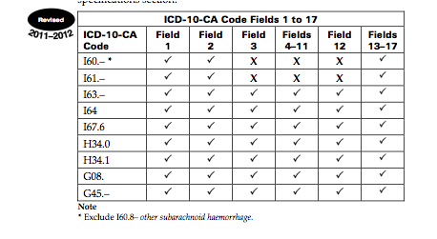
Recap – Inclusions and Exclusions

Slide 60
FAQs
For Patients Seen in the emergency department and then admitted to same facility acute Inpatient bed – is Project 340 only captured on the DAD?
    Yes, a facility only needs to capture it once. If the patient is admitted then the DAD record should be completed. Only use the NACRS SP340fields if there was no inpatient admission.
If a patient is being transferred back to an acute local hospital (from another acute hospital) and the most responsible diagnosis is still being coded as a qualifying stroke diagnosis, should this admission be included or excluded from project 340?
    Yes, the original admitting hospital should complete project 340. The receiving hospital may choose to do 340 as well to track their stroke cases, but some of the fields may no longer be applicable to the second hospital.
Notes:
Since the start of SQC_SP340 we have received many questions and case examples that may not fit exactly into the information provided in this training of the CIHI Dad and NACRS manuals
We have collected all those inquiries and sorted them into an FAQ document which can be found on the CSN best practices website as noted at the bottom of all slides
A few more common examples are included here. Please refer to the full document for additional examples.

Slide 61
FAQs
Do patients have to be admitted from the emergency department in order for them to be included in the DAD special project 340 data collection?
    No, any stroke admission to inpatient care is valid.
For sites that do not administer acute thrombolysis (tPA), should the field for tPA administration be coded as ‘N’ (No- the patients did not receive tPA) or ‘8’ (the facility does not provide tPA)?
    If the hospital caring for the patient does administer tPA and the patient had an ischemic stroke but did not receive tPA code ‘N’ for No.
    If the hospital does not administer tPA then code ‘8’.
Notes:
Here are some more examples

Slide 62
FAQs
If a CT scan was done at hospital A and the patient is transferred to hospital B and another scan is performed (both within the 24 hour period), two values would apply:
Y = at this institution
P = completed prior to transfer
Does "Y" take precedence over "P”?
    Correct. The response to this should be ‘Y’
Notes:
Yes will always take priority over ‘prior’ for brain scans. This is the only data element where this would apply in SP340

Slide 63
FAQs
If the patient is admitted with an ischemic stroke and then goes on to suffer a subsequent hemorrhagic stroke during the same admission, would the stroke project would refer only to the initial stroke?
    In this case it is the initial stroke that is the one to track. The hemorrhage at that point is considered a complication. The antithrombotic medication at discharge, however, becomes 8 (not applicable) if it is not prescribed.
What if the patient suffers a second stroke while in-hospital? Are participating hospitals expected to collect the project multiple times if applicable?
    If a person has a second stroke in hospital, you only complete the data once. Onset time should be for the first stroke as well as CT. Stroke unit, antithrombotics and tPA can be based on either or both.
Notes:
A second stroke in hospital – usually of the initial diagnosis is TIA, would be considered a complication and listed as a type 2 diagnosis

Slide 64
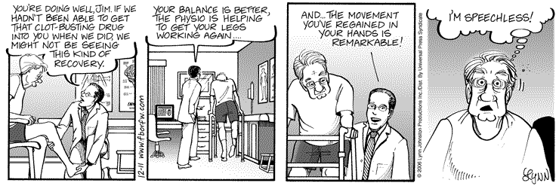
Tracking and Improving Stroke Care
DOES Make a Difference
Notes:
A final note to emphasize that when good stroke care is delivered to patients, it makes a big difference in their outcomes.
Everyone at the hospital is part of the team that makes this happen!

Slide 65



Thank You!
For additional questions or guidance, please contact Dr. Patrice Lindsay: patty@canadianstrokenetwork.ca
Notes:
Thank you for your time.
Do you have any other questions?
Please send us questions and refer to the FAQs for trouble shooting.

